Slide 1
St Thomas More Catholic Voluntary Academy

Slide 2
Let us begin with a prayer

Slide 3
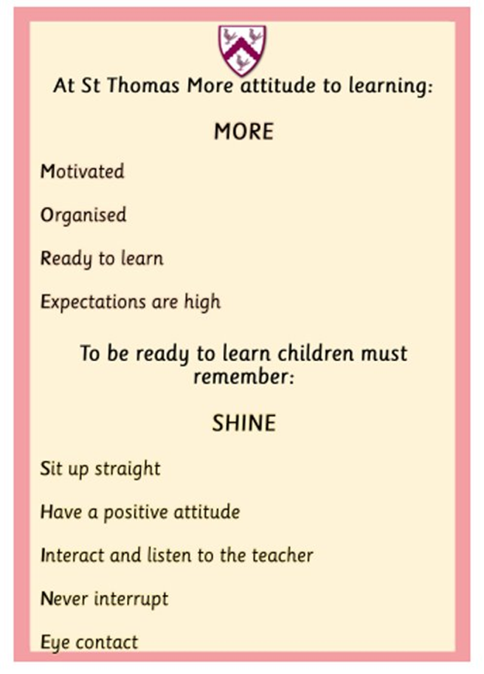
Behaviour

Slide 4
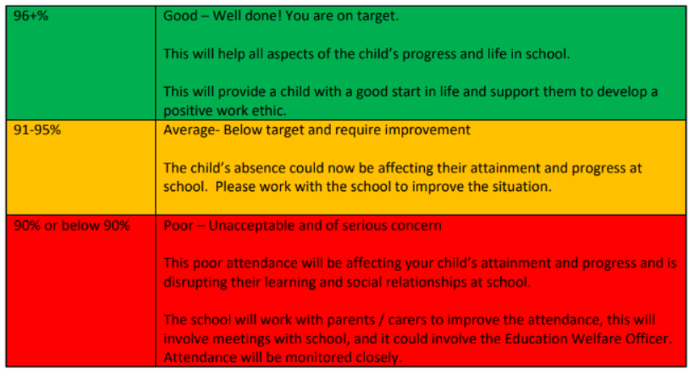
Attendance

Slide 5
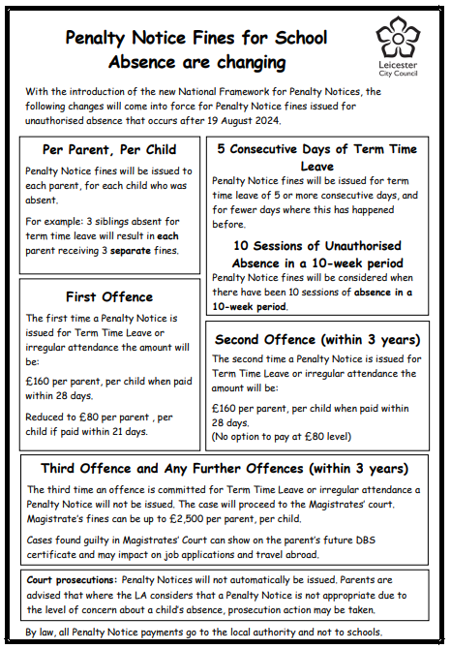

Slide 6
Transition into school
Pentecost Term – Visits to children’s pre school settings.
28th or 29th August – Classroom visit (3 hours - morning or afternoon)
Monday 1st September – Child to start school full time.
Notes:
Complete forms – including a permission to collect form/allergies etc by May Half Term
Children to attend the classroom visit in their full uniform and children will need a bottle filled with water only and their bookbag. Photos will be taken on this day to use in the classroom.
Any medications should be given to the office and a medical form completed.

Slide 7
Other activities to support with transition into school
Friends Summer Fest – Saturday 14th June 2025
Friends Welcome Event – Advent Term
Phonics Meeting – Advent Term

Slide 8
Communication
From Arbor will be used for:
Booking and paying for school dinners
Paying for school trips/clubs
Newsletters and letter communication
Parents evening bookings
Reminders
Notes:
Arbor can be used by downloading the App or using through a web browser.
A link to set up your parent account will be emailed at the beginning of the school year.

Slide 9
Tapestry
Tapestry is an online learning journey where we share photographs, videos and notes of special moments of your child in school.
An overview of our learning and home learning challenges are also shared on Tapestry.
Notes:
Use iOS or Android apps to receive new entries in your child’s journal celebrating their achievements and exciting activities. Contribute to this growing journal by commenting on the journal entries, or even adding your own. Let us know what your child loves doing at home by sending photos and videos back, helping us to understand their interests at home.
Log in details will be emailed to you at the beginning of the school year.

Slide 10
The School Day
8:40 – Start of the school day (Welcome and morning activities)
8:50 – Register
9:00 - (Whole class carpet sessions, adult directed activities & child- initiated play inside/outside)
11:45 – Lunchtime
12:45 – Afternoon activities (Whole class carpet sessions, adult directed activities & child-initiated play inside/outside)
3:10 - Home time
Notes:
Children will enter school via the green gate on Newstead Road.
Gate closes at 8:50 – if late enter through the office.
Fruit for snack will be provided. If you would like to provide your own snack this needs to be fruit only.
Milk free for under 5’s. Option to pay for milk if parents wish to continue with this.
Children leave through the gate on Newstead Road at 3:10.

Slide 11
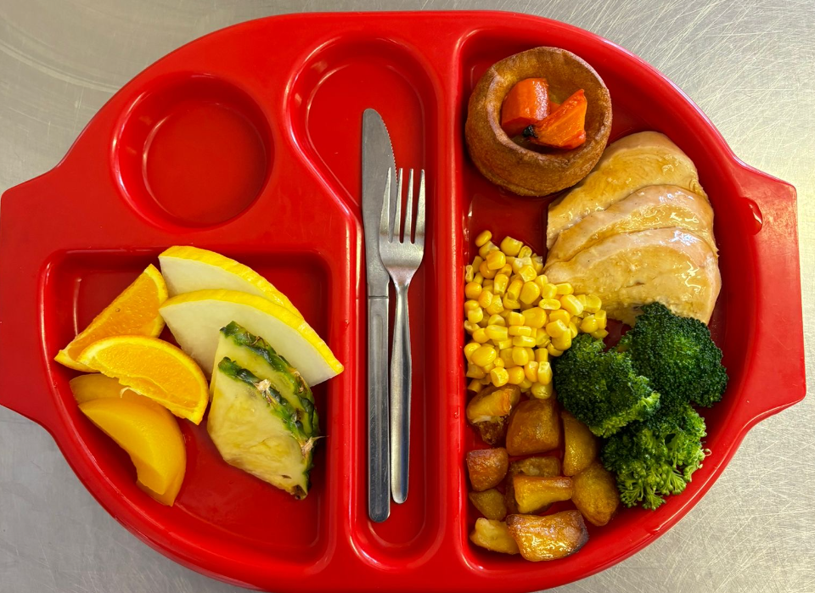
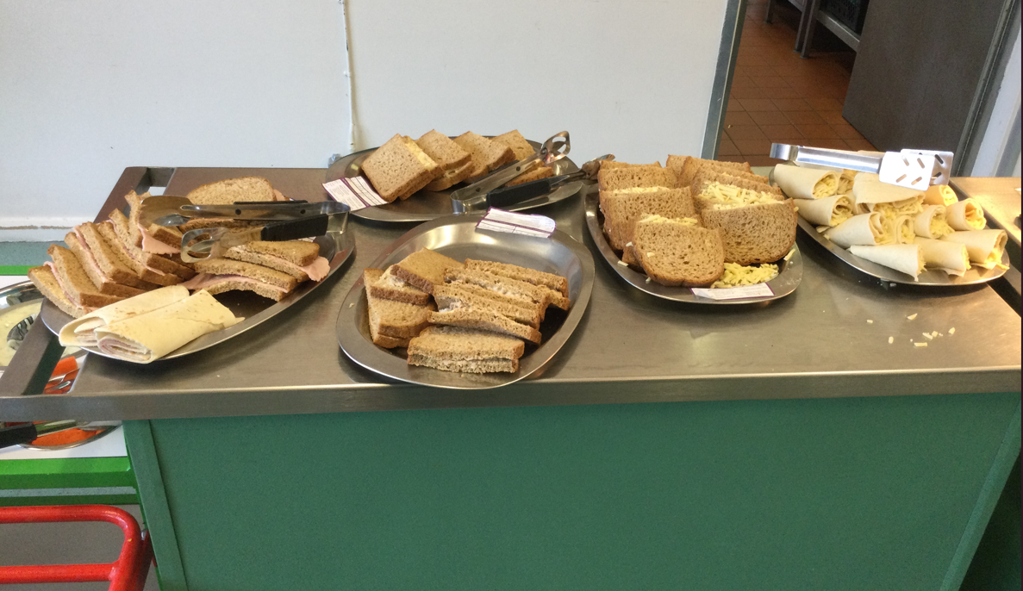
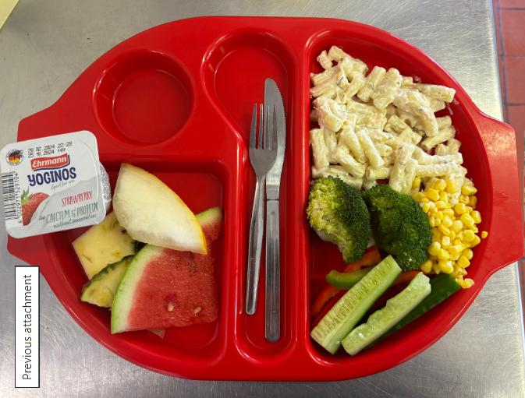
Lunchtime
Notes:
All children in Reception and Key Stage 1 are entitled to a free school meal.
The children will have the choice of a main meal or a deli option (JP/wrap etc).
These should be chosen with your child at home through Arbor.
If your child has any allergies, please complete allergen form.

Slide 12
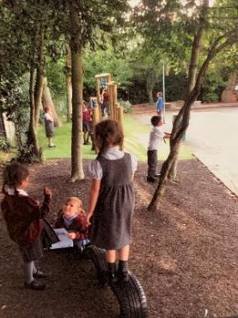
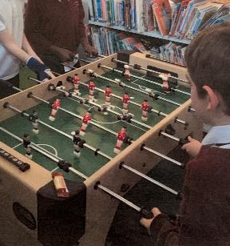
Breakfast Club
Open from 7:45
£4.50 a session
After school Club
Open until 5:30
£10 a session
If you are interested in either of these clubs, please complete the booking form found in your packs.

Slide 13
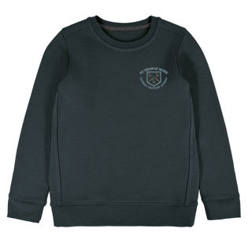
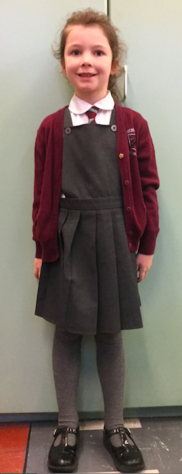
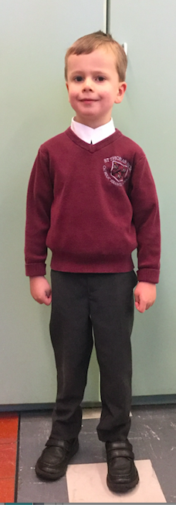
What will my child need?
Notes:
Bookbag & water bottle (Only with water)
Plimsolls/We will be outside in all weathers. Please ensure your child is dressed appropriately.
Wellington boots and waterproof suits can be left in school.
Please ensure everything is named!!

Slide 14
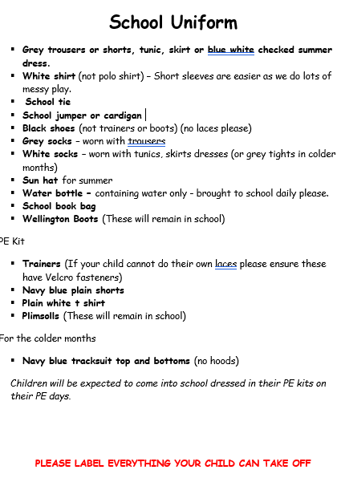
School Uniform
School uniform can be purchased from Schoolwear Solutions in Oadby. https://www.schoolwearsolutions.com
Uniformed – Pre loved uniform can be purchased from the Friends of STM.
Uniform without a logo can also be purchased from a local supermarket.
(trousers, dresses, shirts, polo t-shirts etc…)

Slide 15
Catholic Life Religious Education

Slide 16
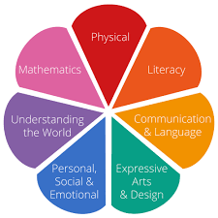
The Early Years Foundation Stage Curriculum

Slide 17
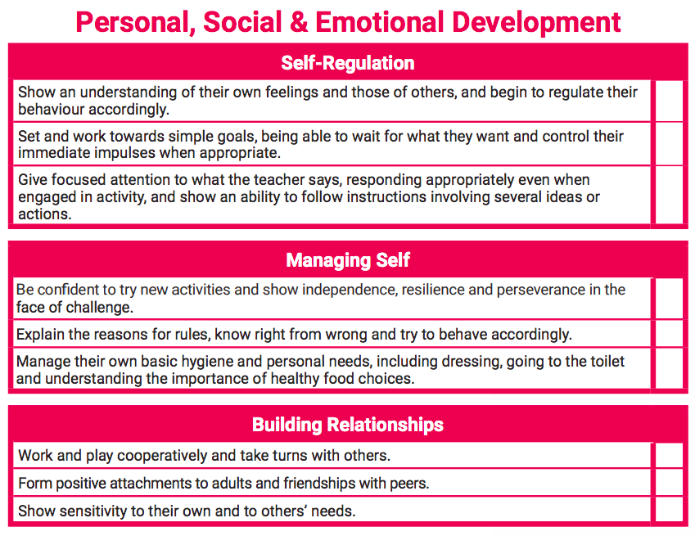
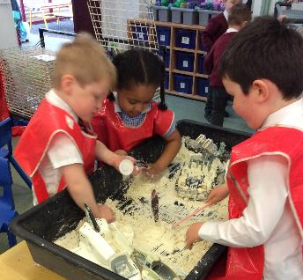
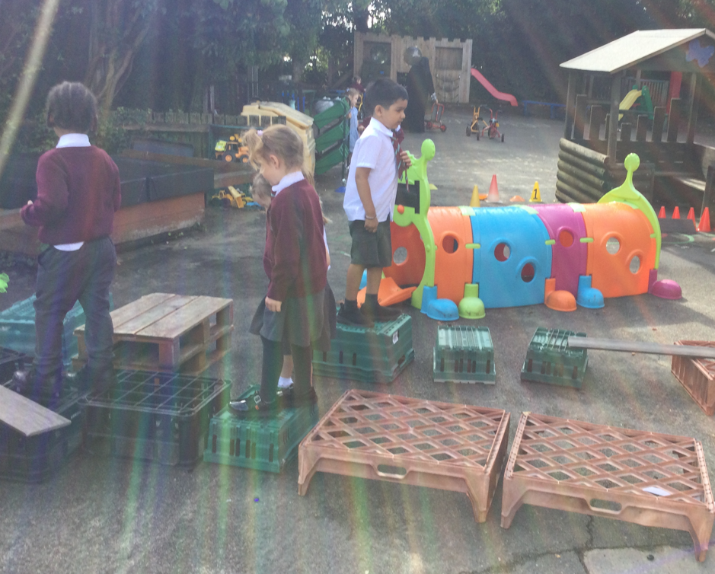

Slide 18
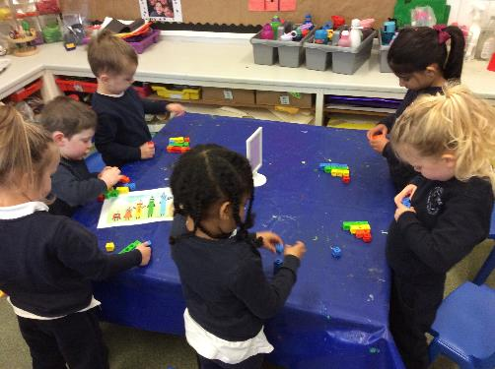
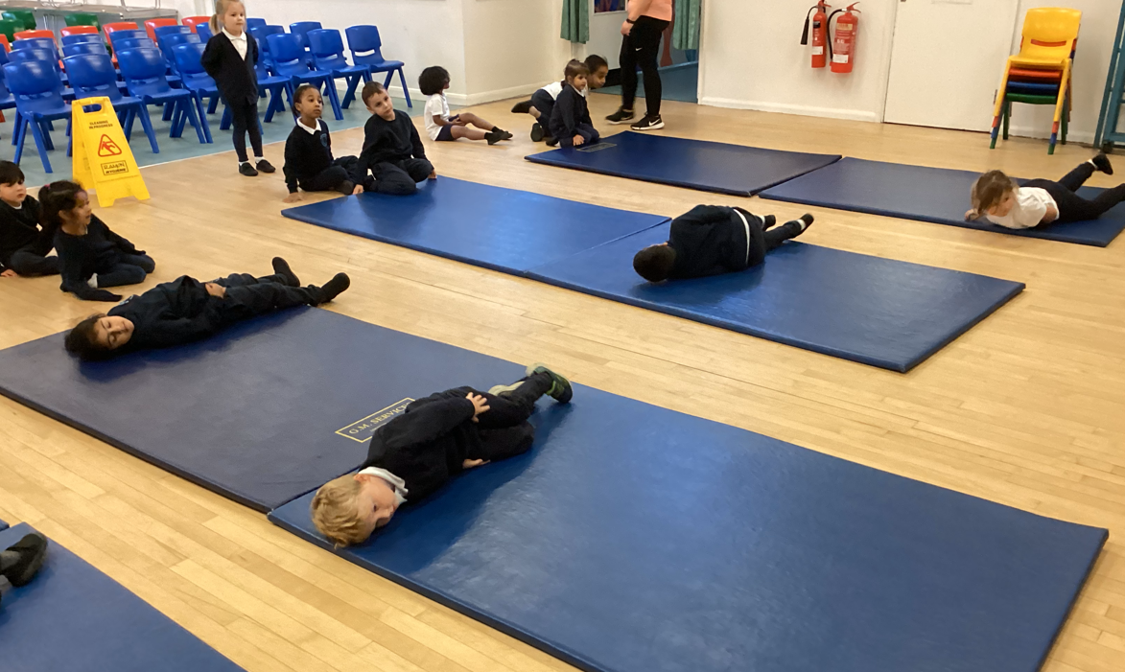
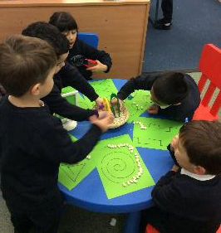
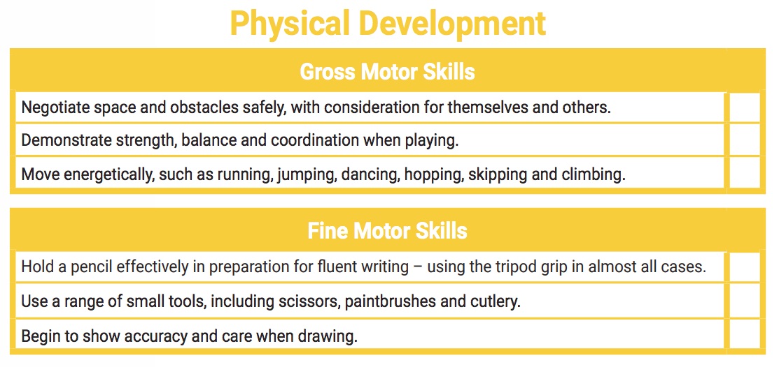

Slide 19
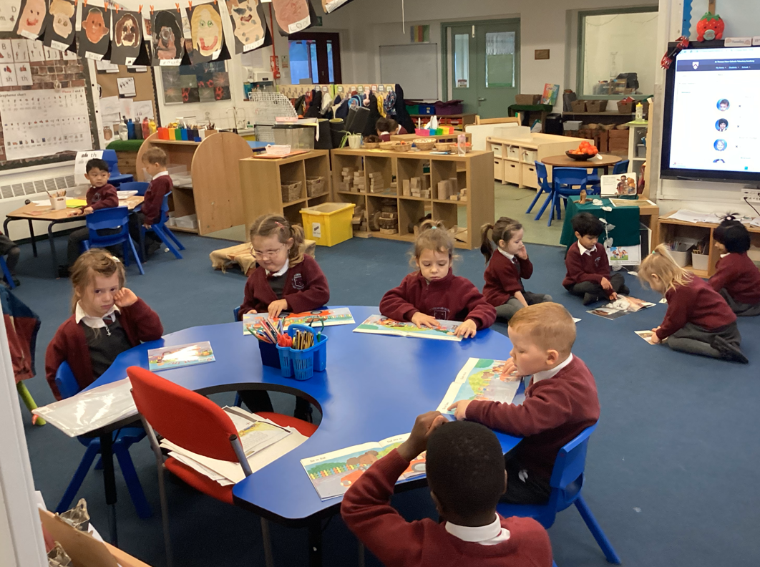
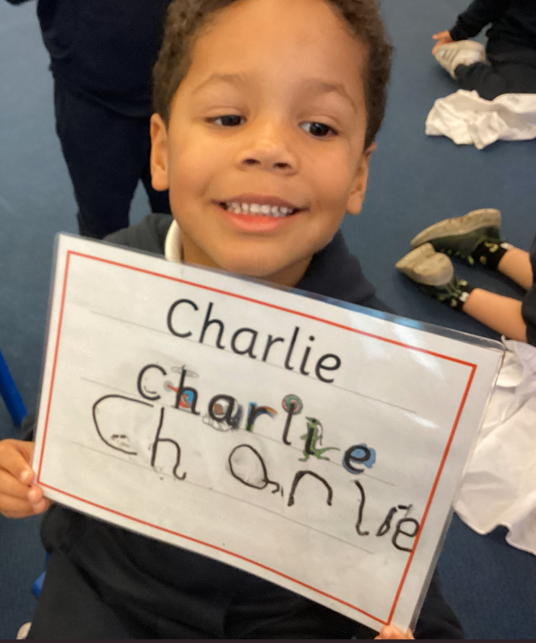
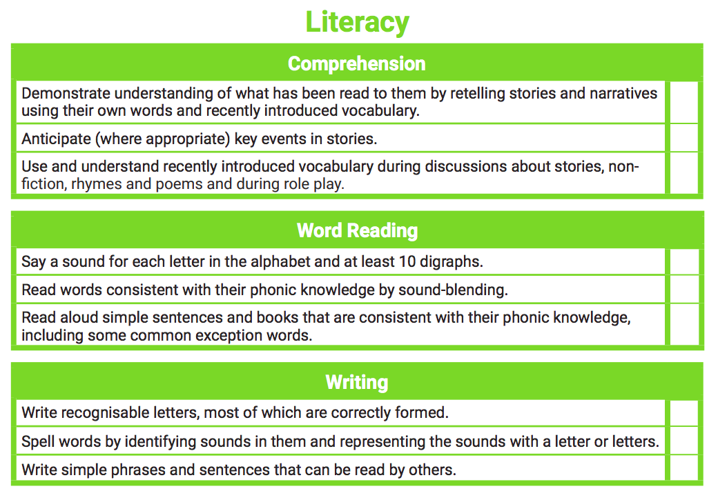
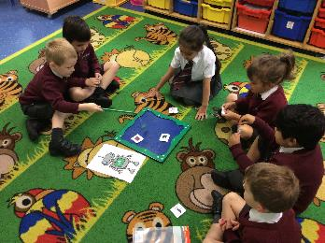

Slide 20
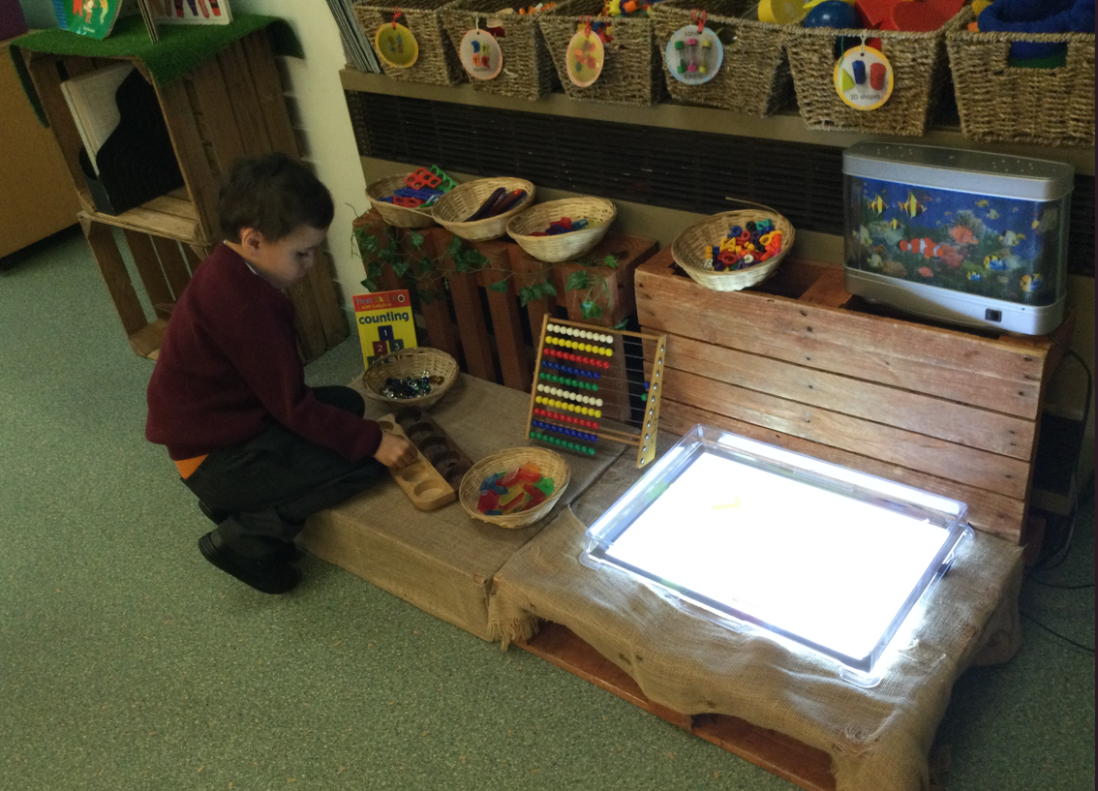
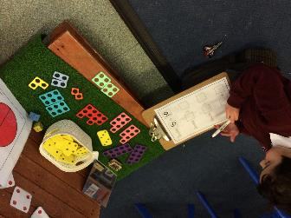
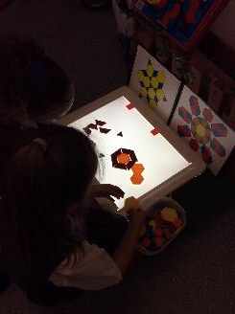
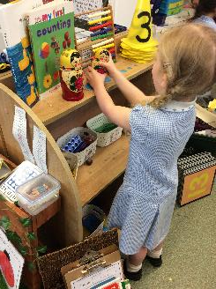

Slide 21
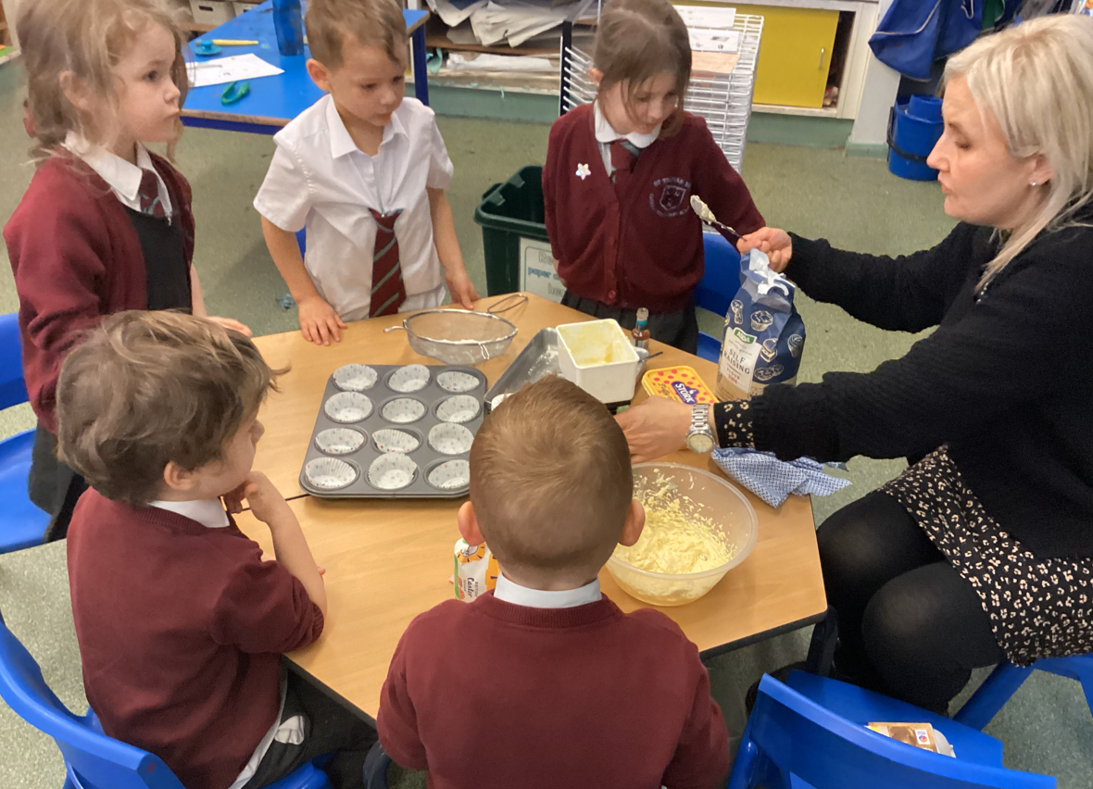
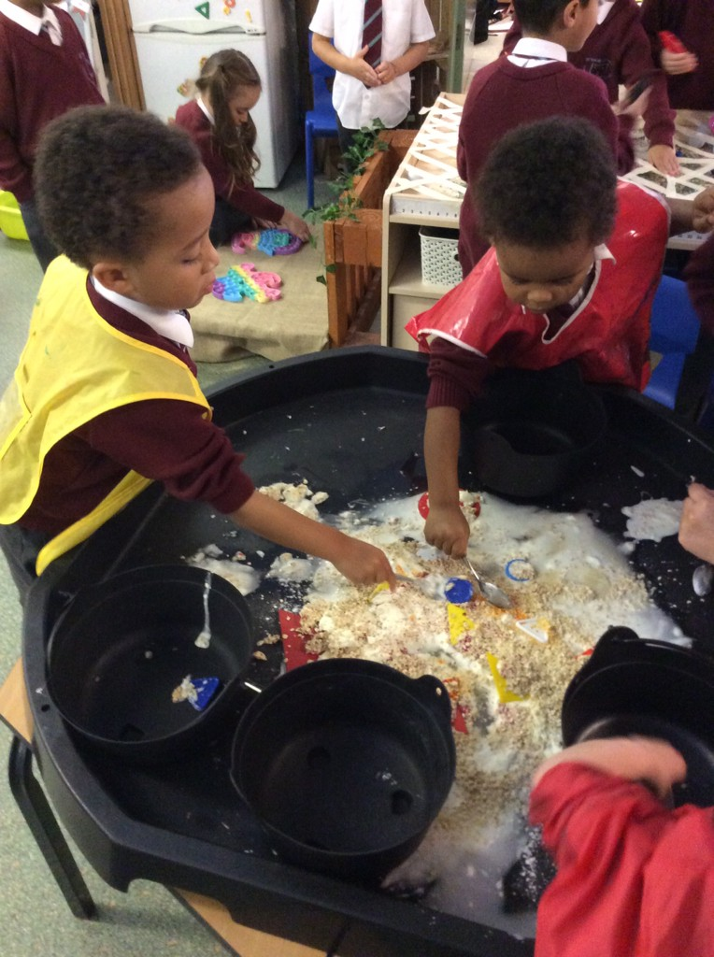
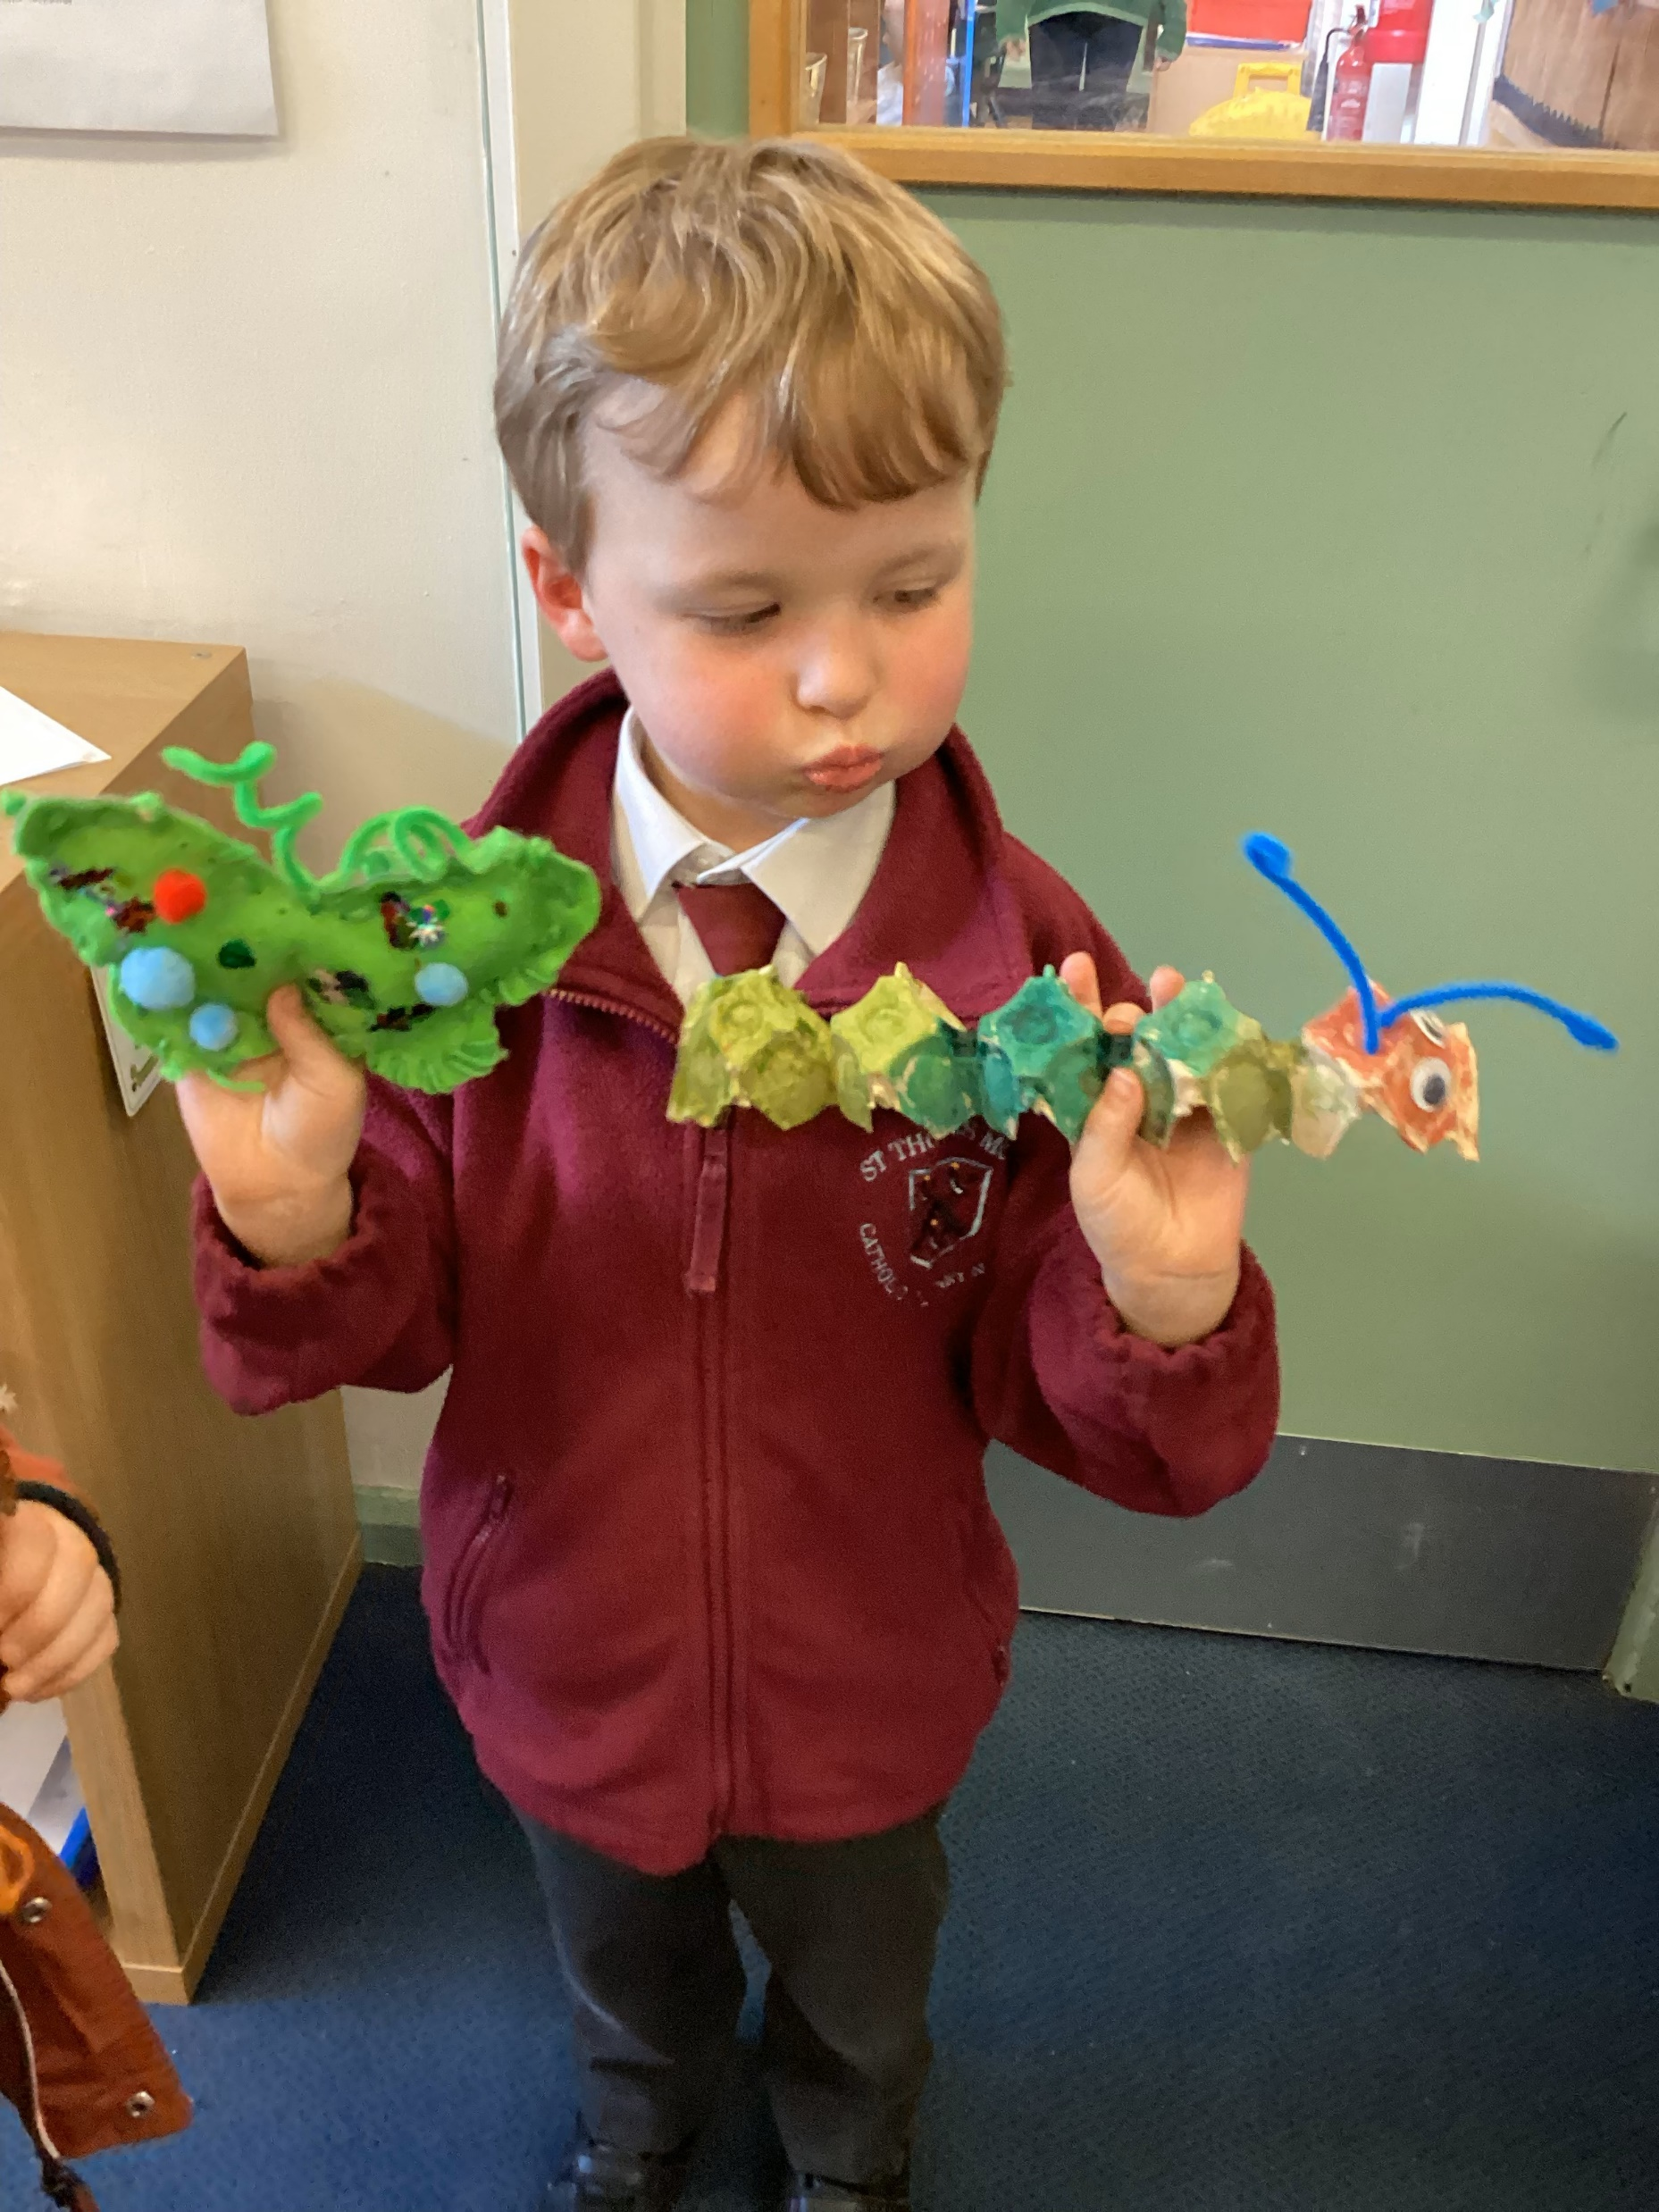
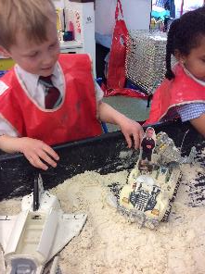

Slide 22
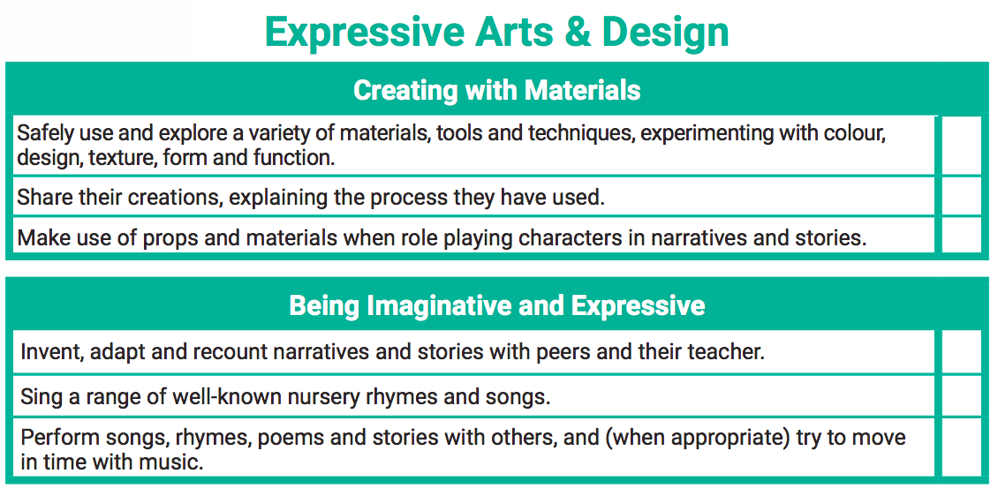
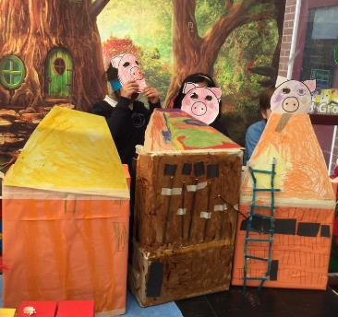
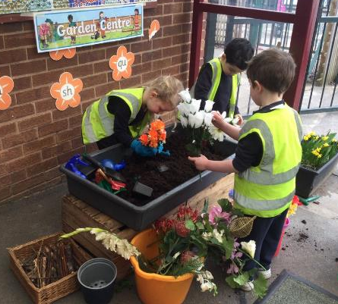
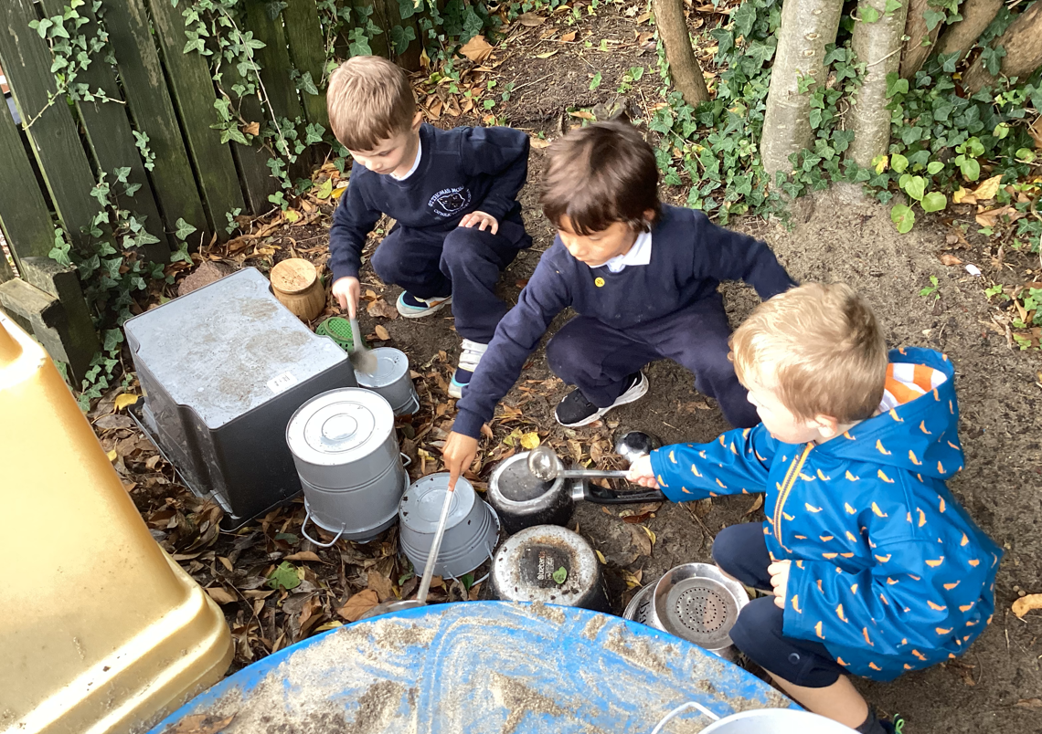

Slide 23
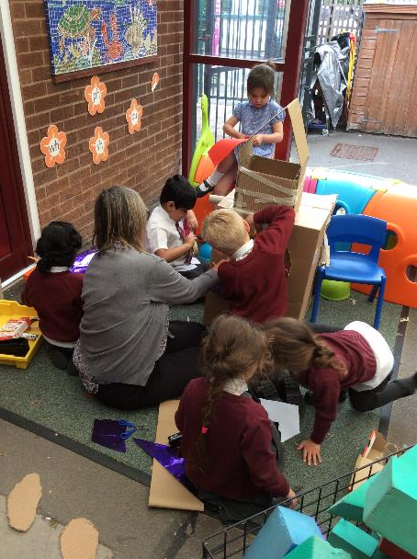
Characteristics of Effective Learning
Notes:
We also observe and note the ways in which the children engage with other people and their environment. These behaviours underpin learning and development across all areas and support the child to remain an effective and motivated learner.
Creating and Thinking Critically – this is having their own ideas, making links and choosing ways in which to do things.
Playing and Exploring – Engagement – this is finding out and exploring, playing with what they know, being willing to ‘have a go’.
Active Learning – Motivation – this is being involved and concentrating, keeping trying, enjoying achieving what they set out to do.

Slide 24
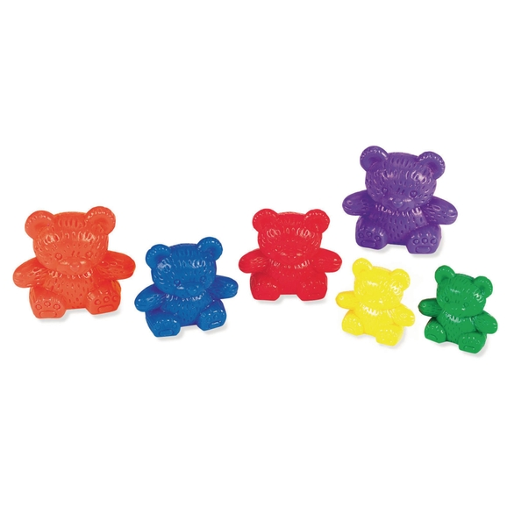
Baseline
Notes:
The RBA is a short, interactive and practical assessment of your child's early literacy, communication, language and mathematics skills when they begin school, using materials that most children of your child's age will be familiar with. It became statutory for all schools from September 2021. This will be completed in the first 6 weeks of your child starting school.

Slide 25
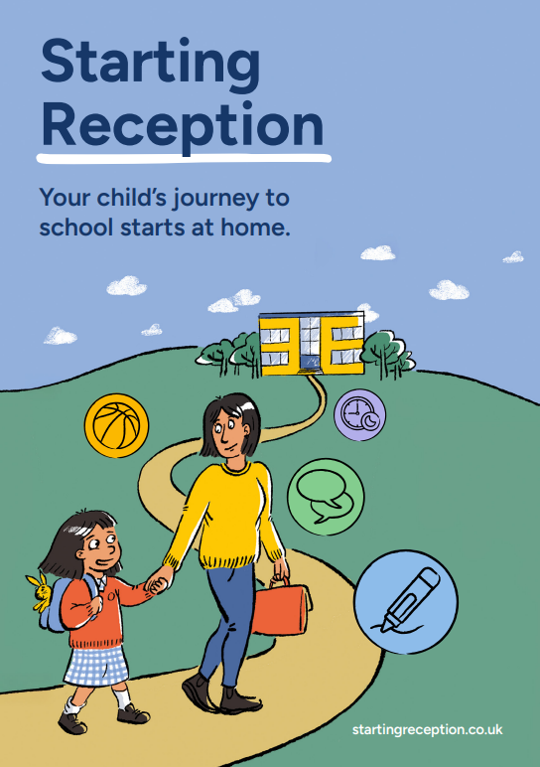
How can I help my child be ready for school?

Slide 26
Any other questions?

