Slide 1
St Thomas More Catholic Voluntary Academy

Slide 2
Let us begin with a prayer

Slide 3
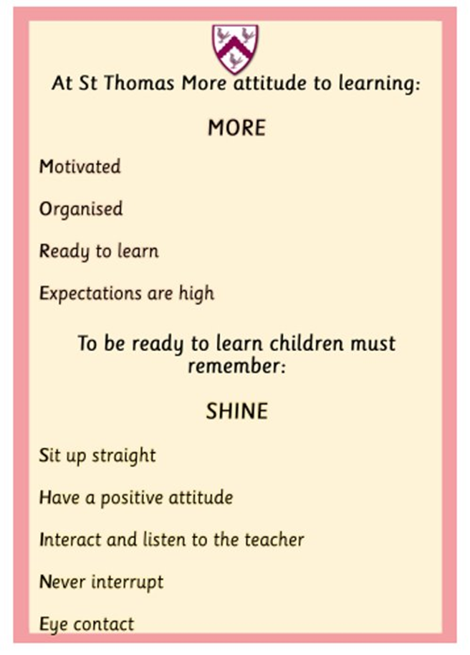
Behaviour

Slide 4
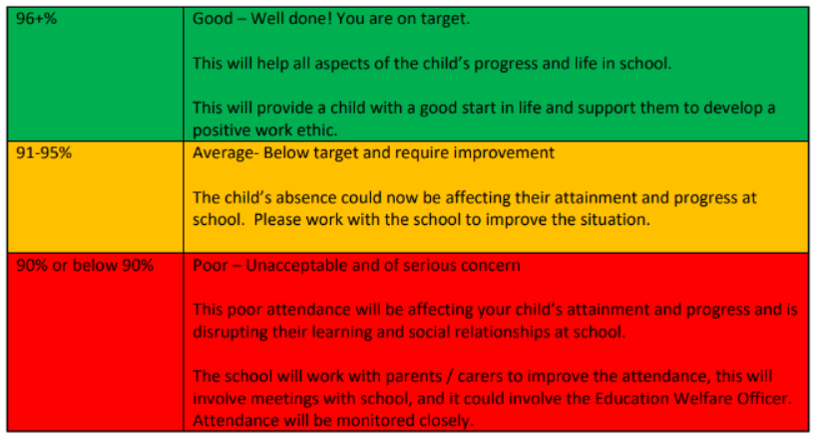
Attendance

Slide 5
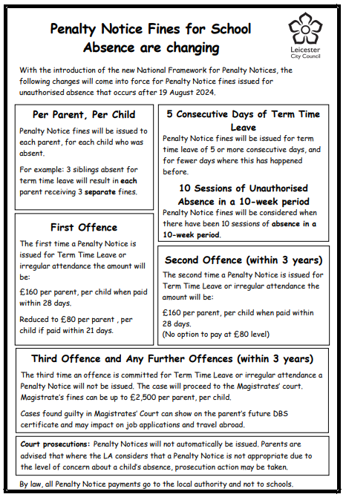

Slide 6
Transition into school
Week commencing 10th June – Visits to preschool setting.
29th or 30th August – Classroom visit (3 hours - morning or afternoon)
Monday 2nd September – Child to start school full time.
Notes:
Children to attend the classroom visit in their full uniform and children will need a bottle filled with water only and their bookbag. Photos will be taken on this day to use in the classroom.

Slide 7
Other activities to support with transition into school
Summer Fayre – Saturday 15th June 2024
Friends Welcome Event – Advent Term
Phonics Meeting – Advent Term

Slide 8
Communication
From September 2024 we will streamline the communication systems we use in school.
Arbor will be used for:
Booking and paying for school dinners
Paying for school trips/clubs
Newsletters and letter communication
Parents evening bookings
Text reminders
Notes:
Arbor can be used by downloading the App or using through a web browser.
A link to set up your parent account will be emailed at the beginning of the school year.

Slide 9
The School Day
8:40 – Start of the school day (Welcome and morning activities)
8:50 – Register
9:00 - (Whole class carpet sessions, adult directed activities & child- initiated play inside/outside)
11:45 – Lunchtime
12:45 – Afternoon activities (Whole class carpet sessions, adult directed activities & child-initiated play inside/outside)
3:10 - Home time
Notes:
Children will enter school via the green gate on Newstead Road.
Gate closes at 8:50 – if late enter through the office.
Fruit for snack will be provided
Milk free for under 5’s. Option to pay for milk if parents wish to continue with this.
Children leave through the gate on Newstead Road at 3:10.

Slide 10
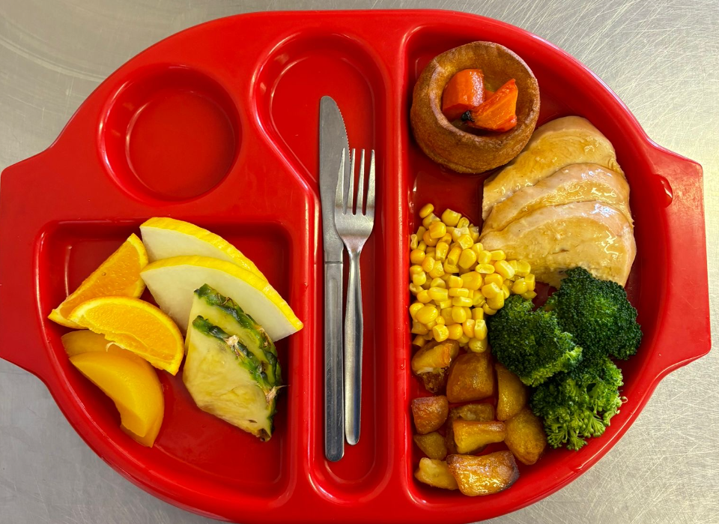
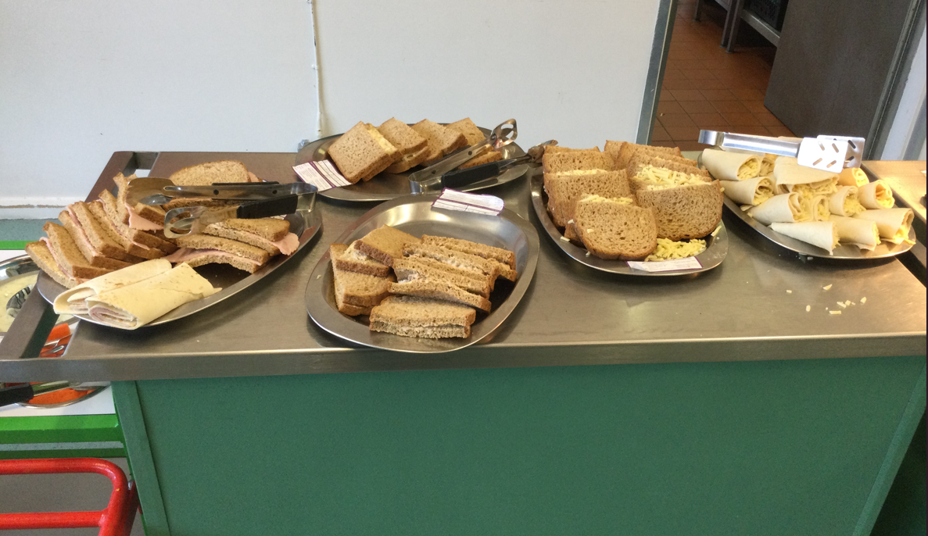
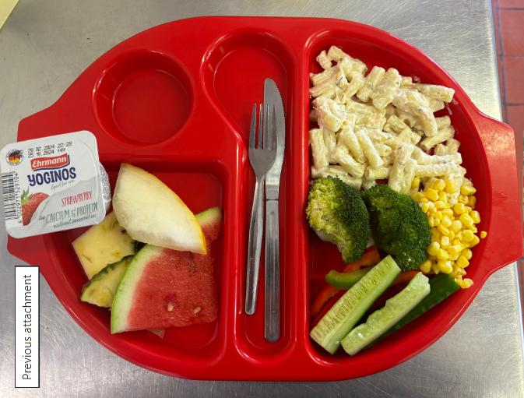
Lunchtime
Notes:
All children in Reception and Key Stage 1 are entitled to a free school meal.
The children will have the choice of a main meal, jacket potato or soup and sandwich.
These should be chosen with your child at home through Arbor.
If your child has any allergies, please complete allergen form.

Slide 11
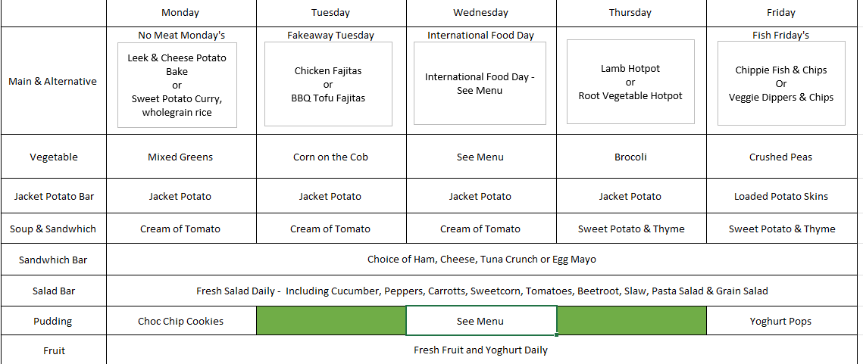
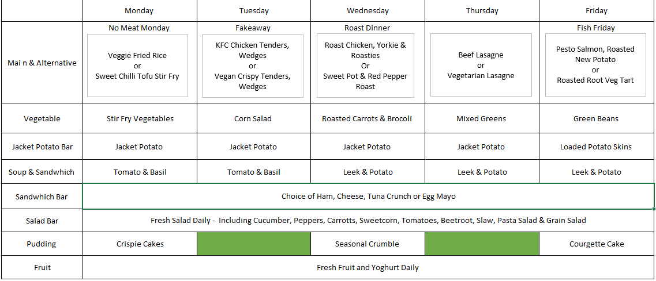
Notes:
Sneak peak of Advent menu…

Slide 12
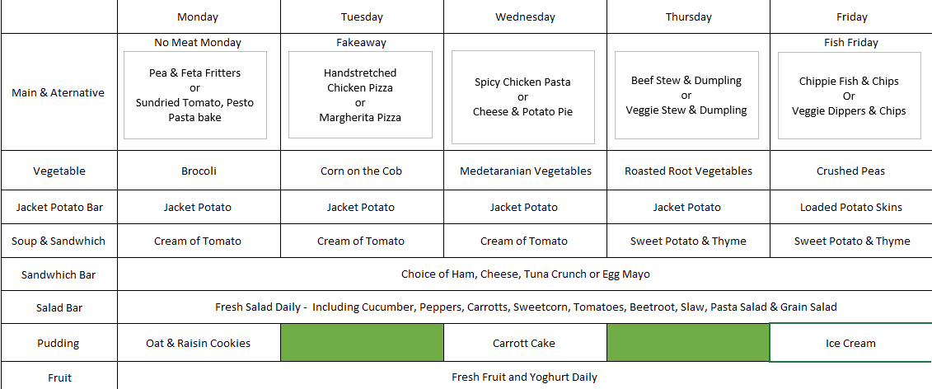
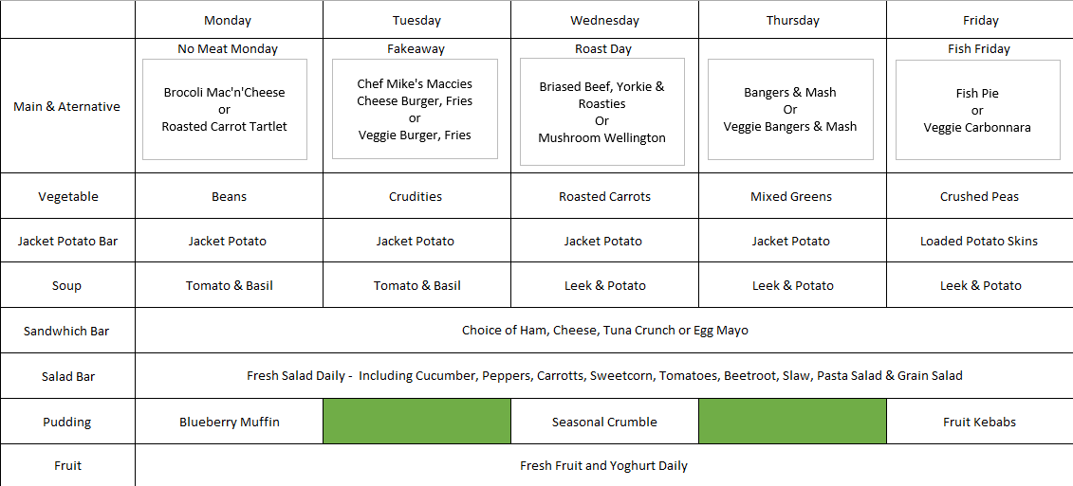

Slide 13
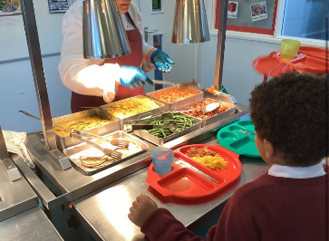
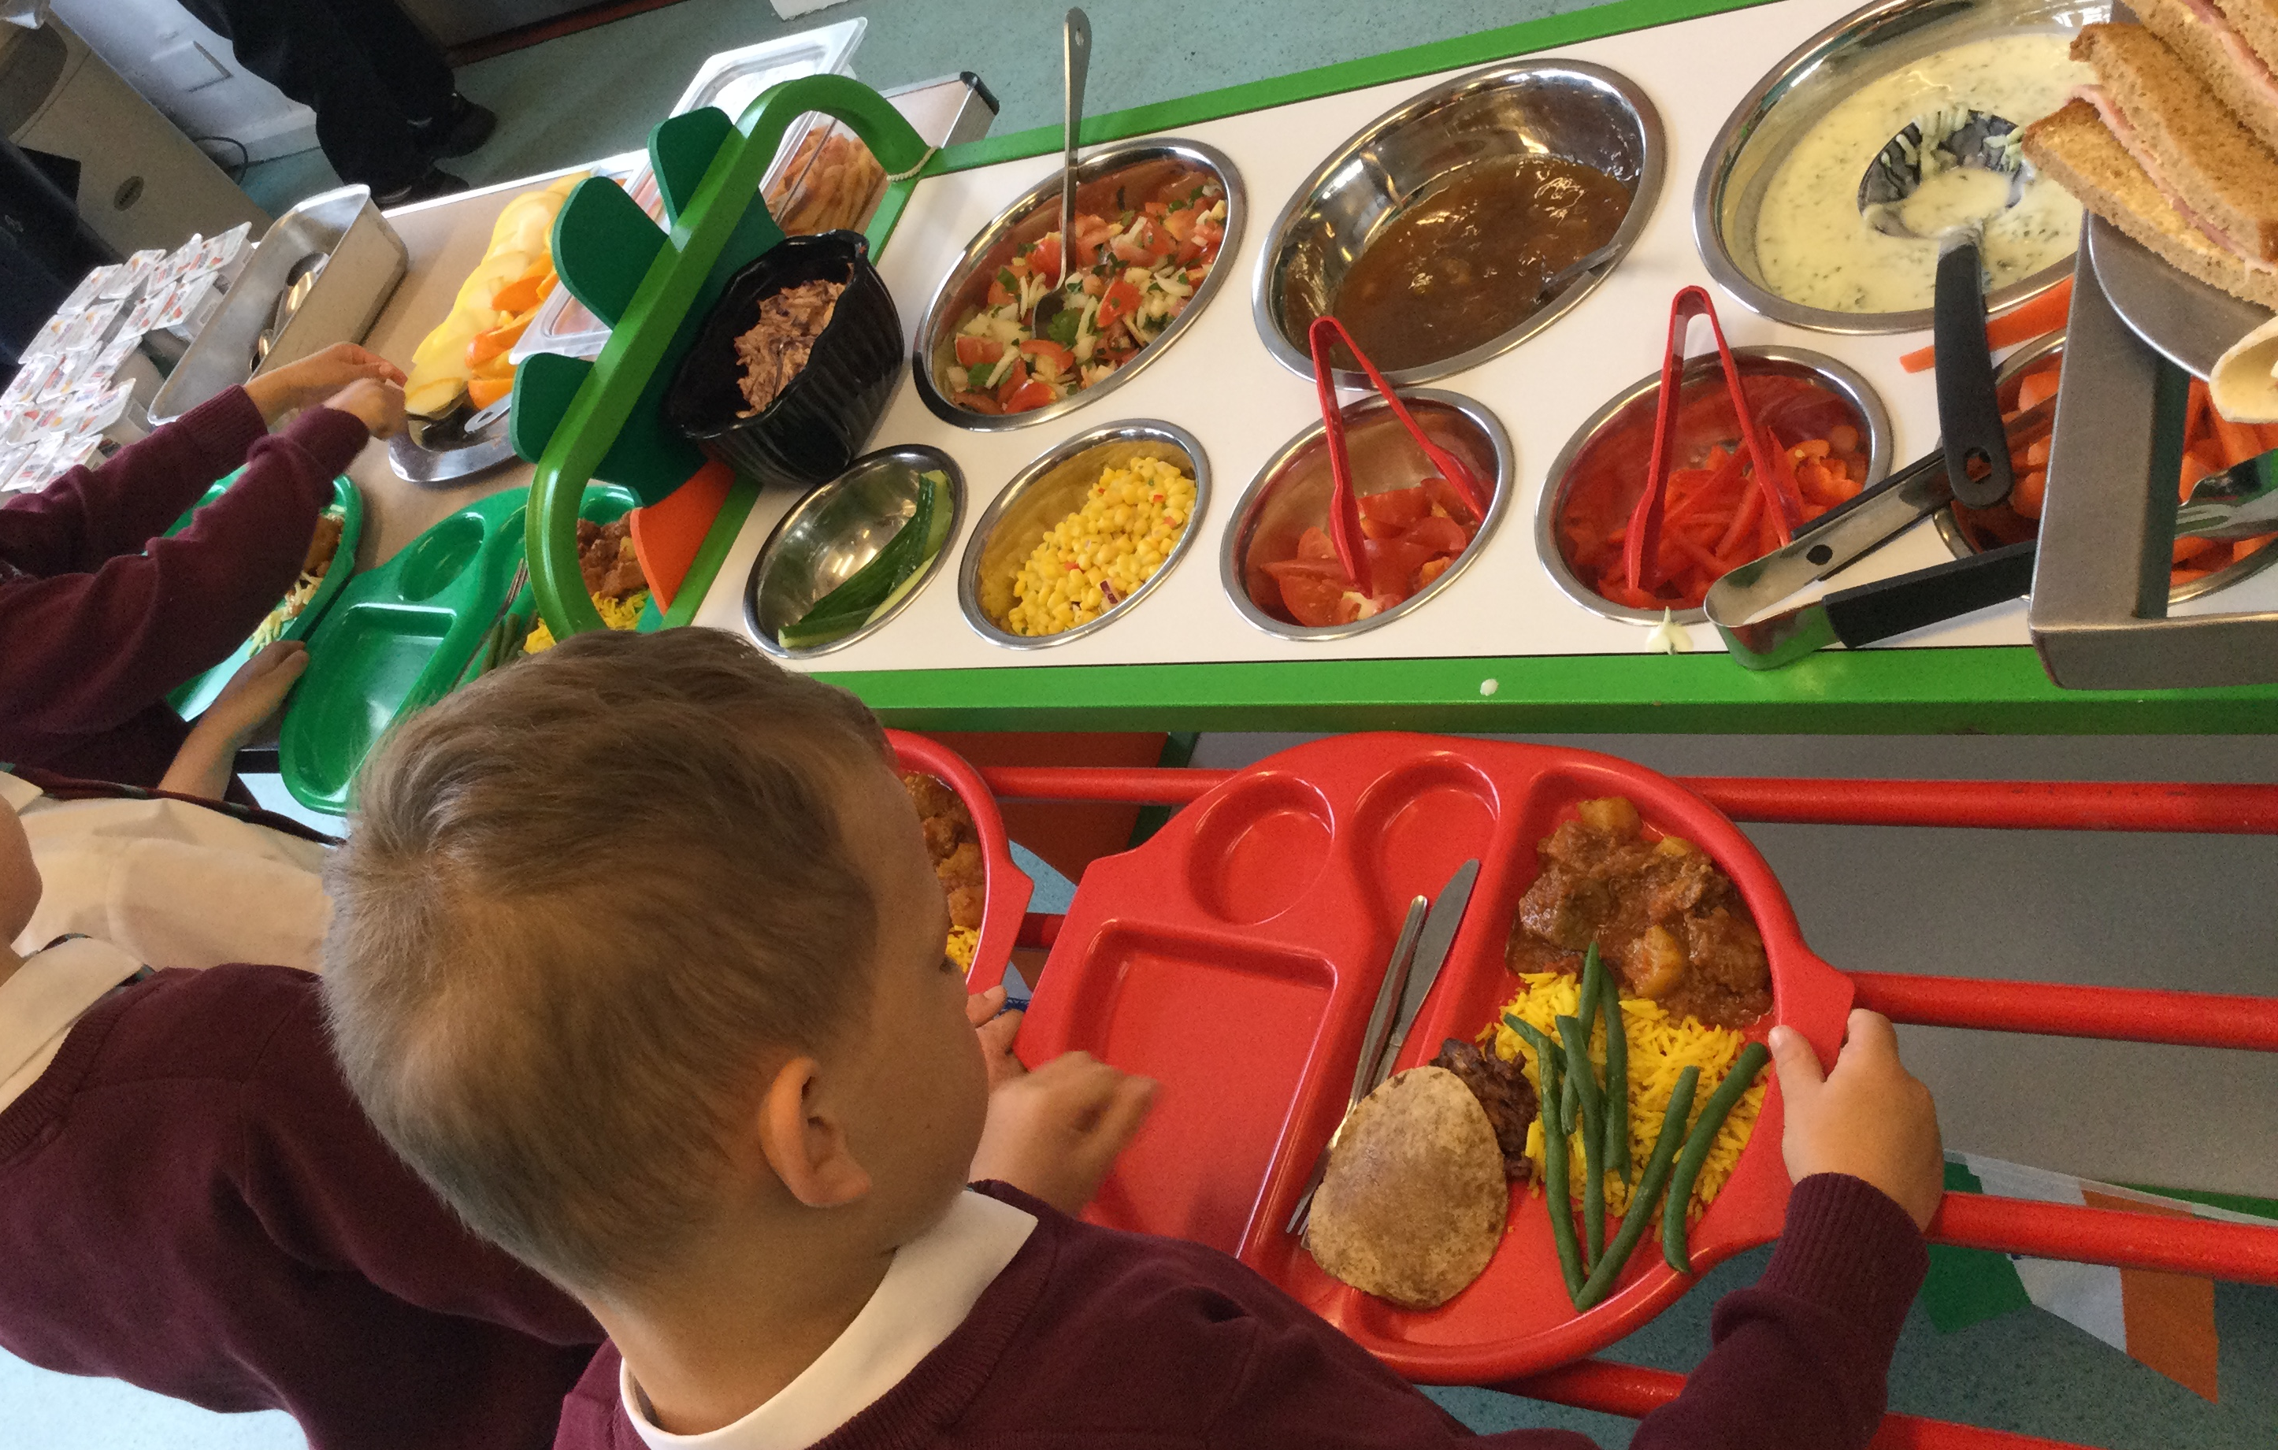
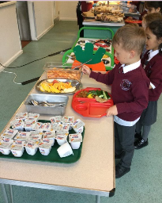
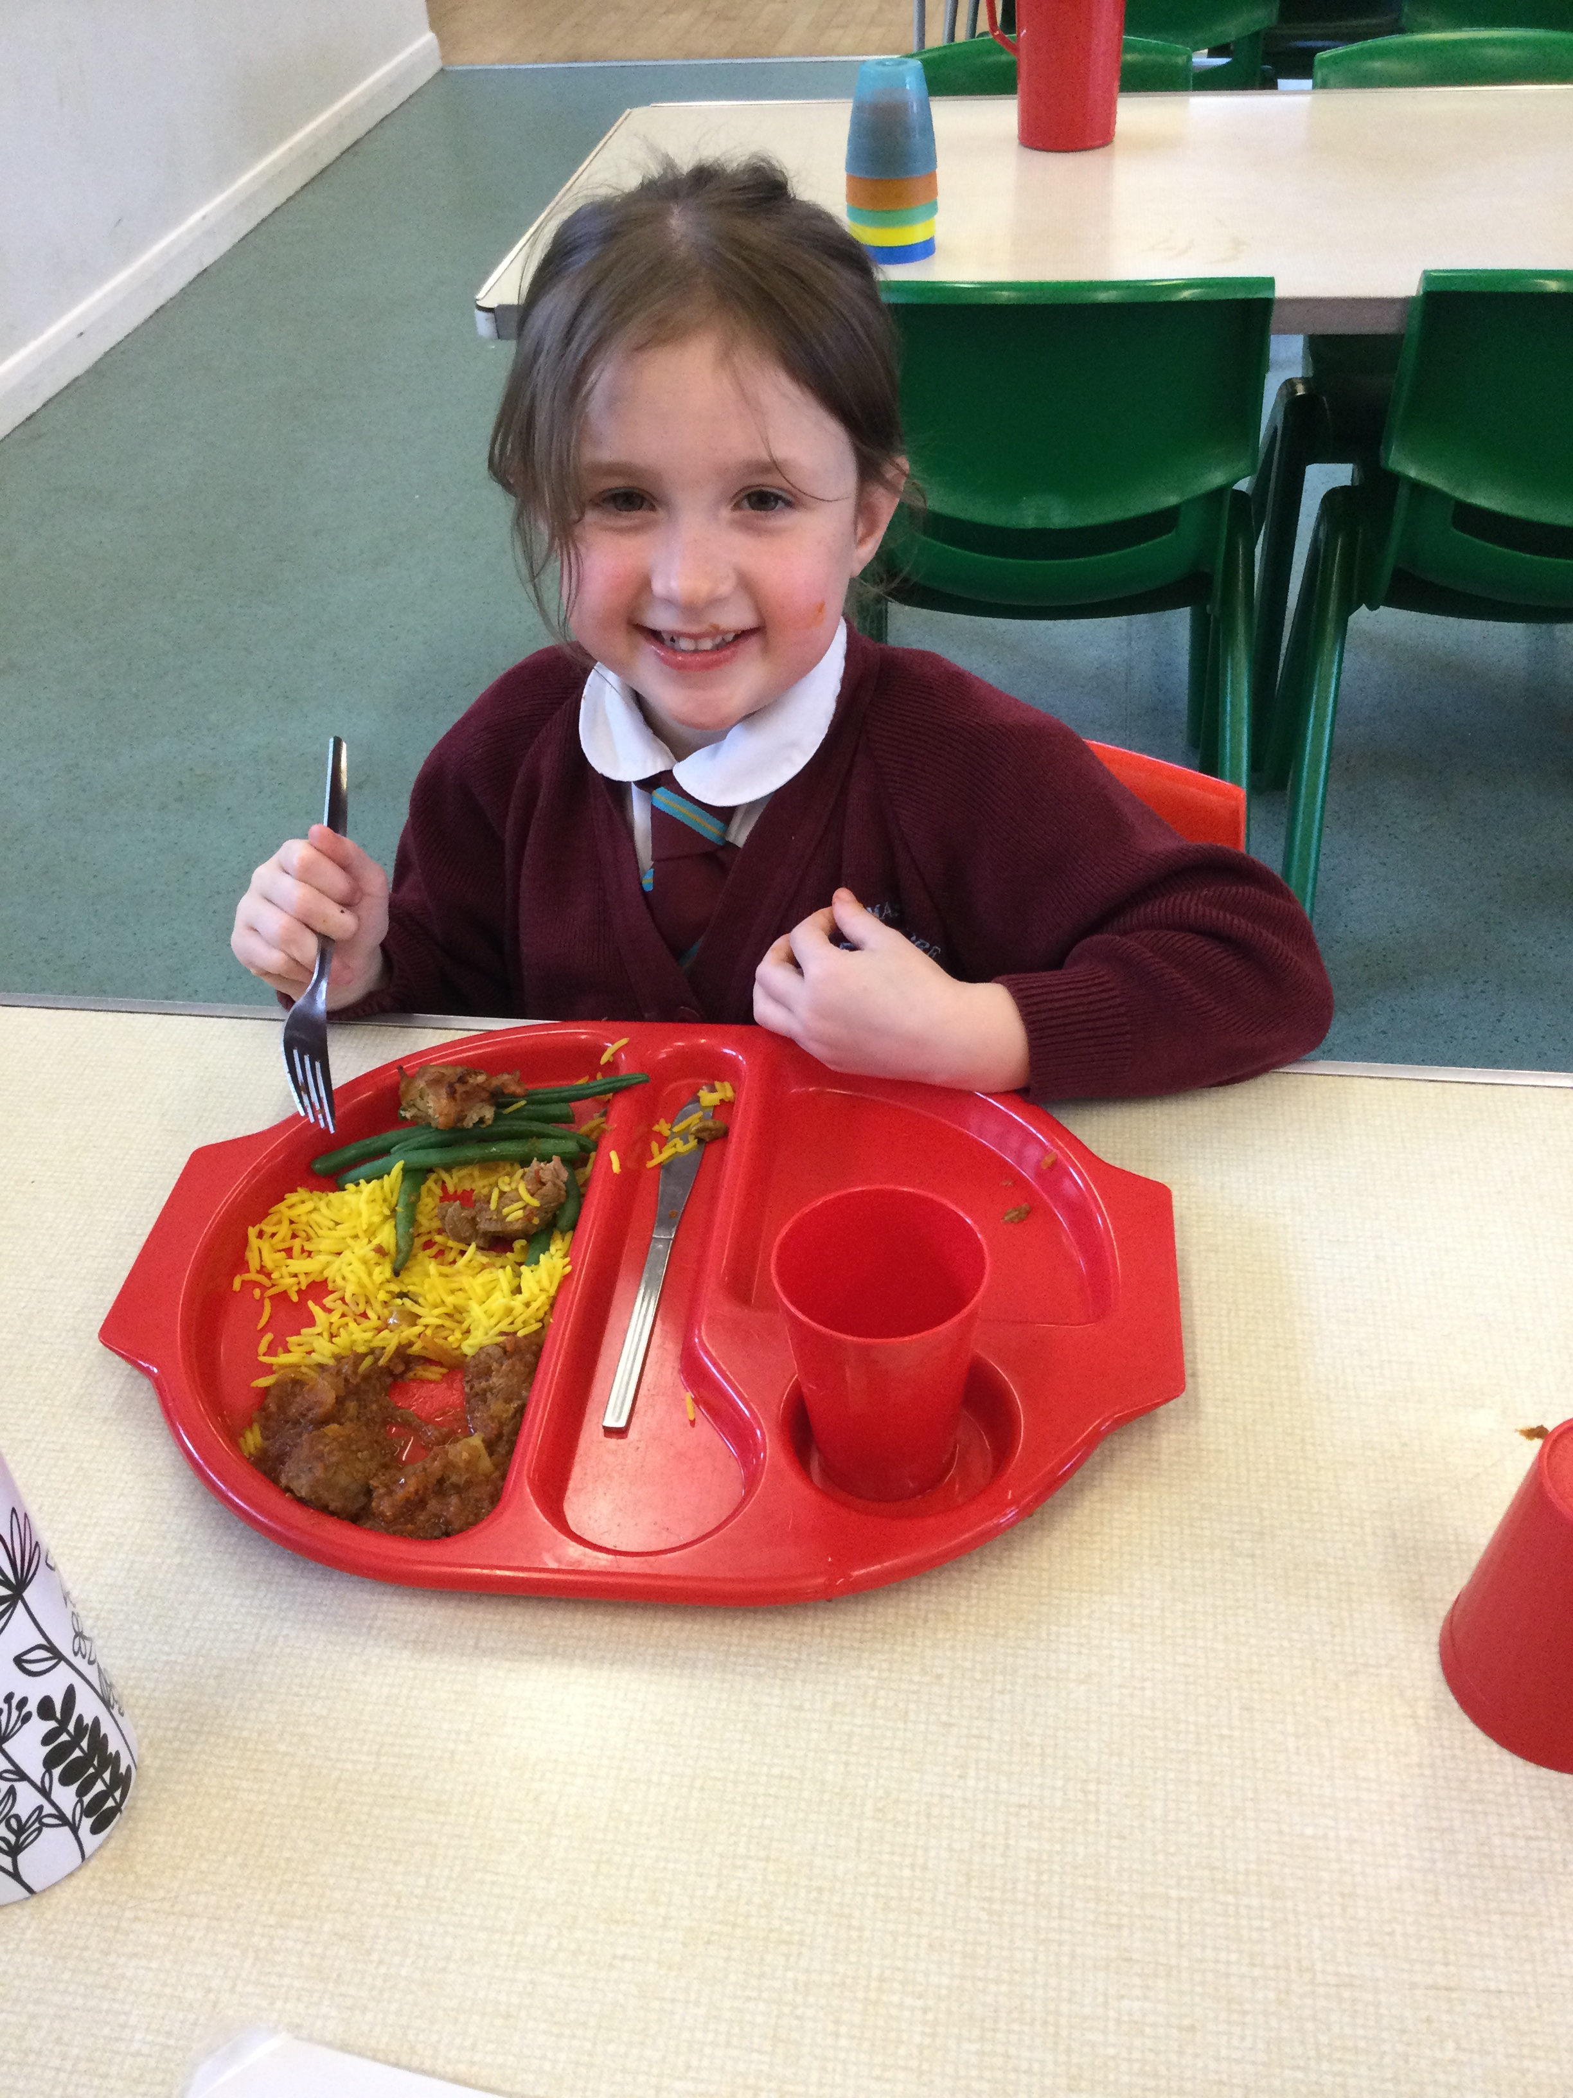
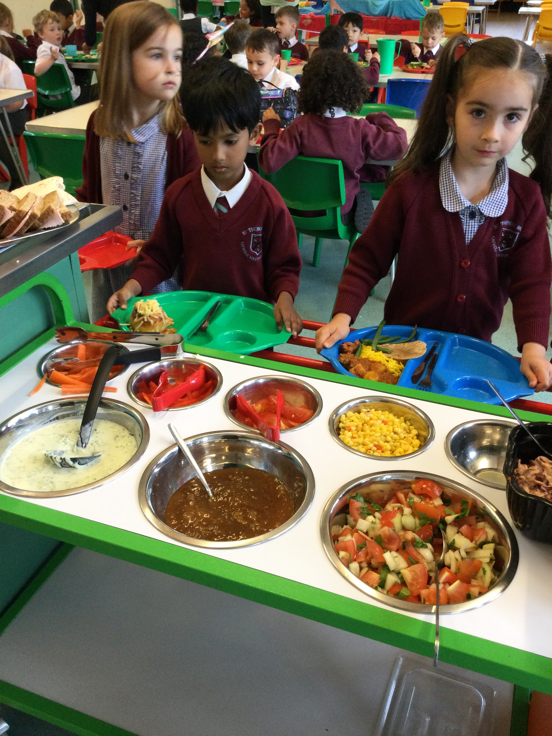
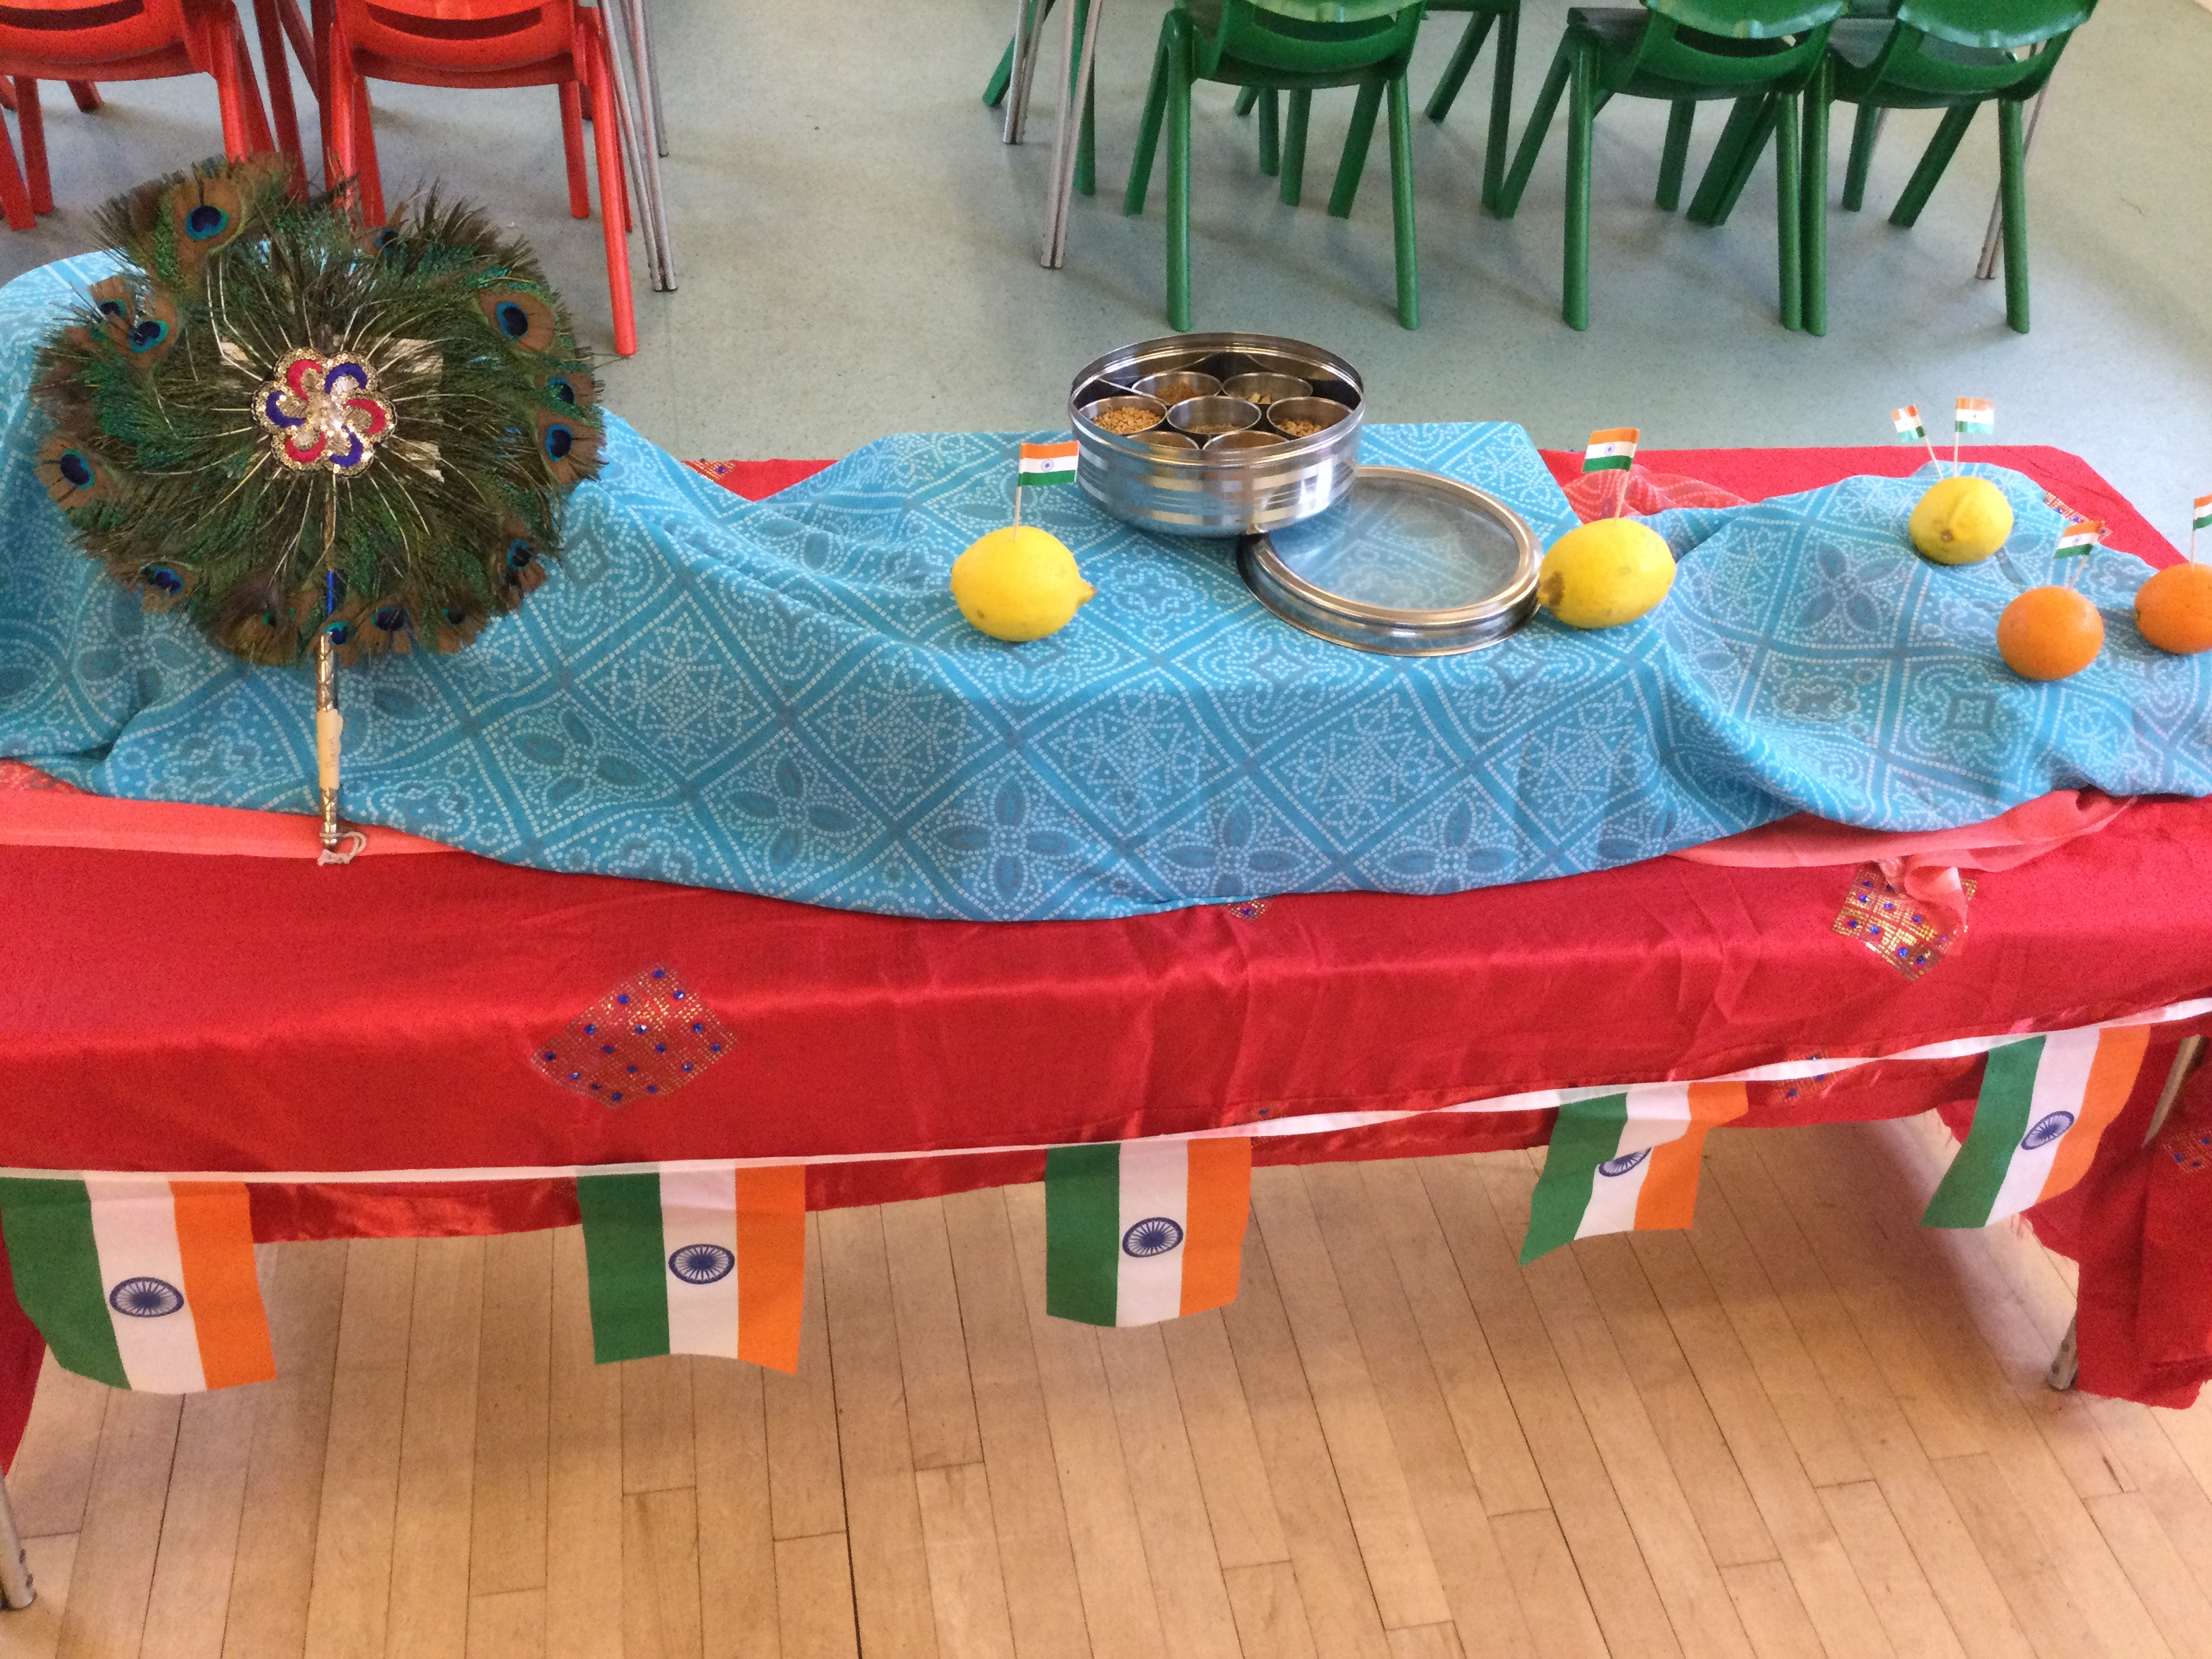
International Food Day!

Slide 15
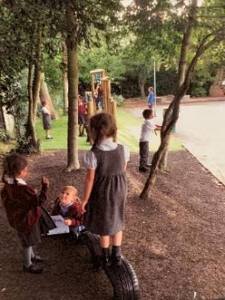
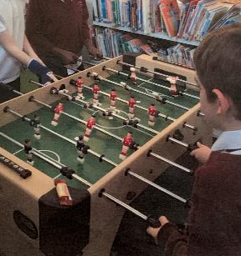
Breakfast Club
Open from 7:45
£4.50 a session
After school Club
Open until 5:30
£9.50 a session
If you are interested in either of these clubs, please complete the booking form found in your packs.

Slide 16
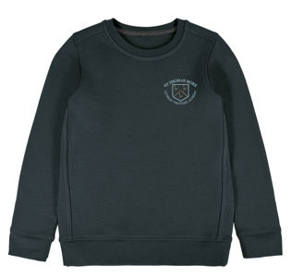
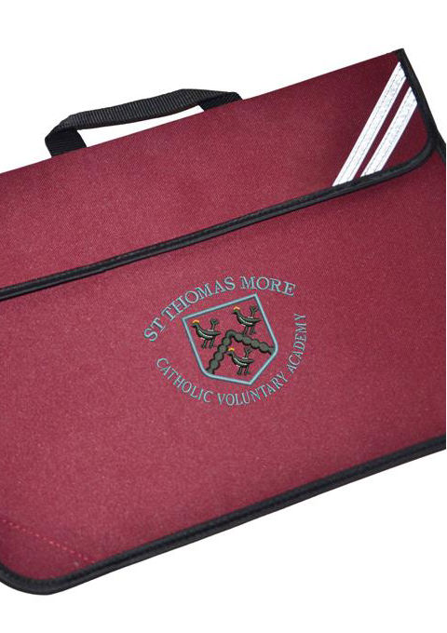
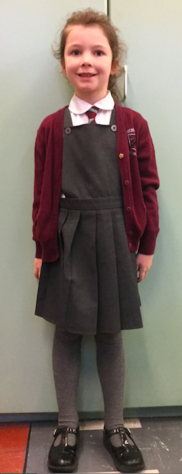
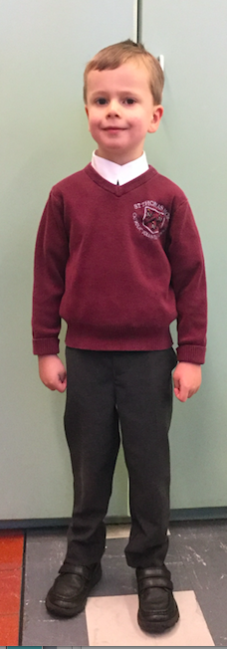
What will my child need?

Slide 17
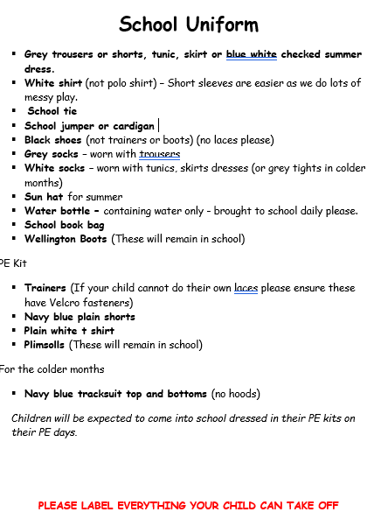
School Uniform
School uniform can be purchased from Schoolwear Solutions in Oadby. https://www.schoolwearsolutions.com
Uniformed – Pre loved uniform can be purchased from the Friends of STM.
Uniform without a logo can also be purchased from a local supermarket.
(trousers, dresses, shirts, polo t-shirts etc…)

Slide 18
Catholic Life Religious Education

Slide 19
Religious Education
From September 2024 we will be delivering a new scheme of work for the teaching of Religious Education.
Notes:
The Religious Education Curriculum Directory has been updated and our school and the schools in the Nottingham Diocese will be following the recommendations in this document.
This document which is entitled To Know You More Clearly sets out the nature and purpose of Catholic Education in England and Wales.

Slide 20
Religious Education
Notes:
This curriculum seeks to present the teaching of religious education in a sequential and progressive form. It follows the Liturgical Year and the children build on the information and skills they have learned as they progress through our school.
It allows for lots of discussion and reflection on the personal impact of our faith and our wider responsibilities as a Catholic school as well as learning the practices and customs of a Catholic community.
We are closely involved with our Parish Church and we regularly attend Mass as a school where we join with the parishioners.
We are an outward looking school and we seek every opportunity to support our local community. We regularly litter pick in the area around our school and there is a food bank in our office reception area which supports the Leicester South Food Bank.
We have a thriving Chaplaincy Team as well as an Eco Team who meet during the school day.
During Advent and Lent we have charity fundraising events to support charities chosen by the children whose work supports Catholic Social Teaching.

Slide 21
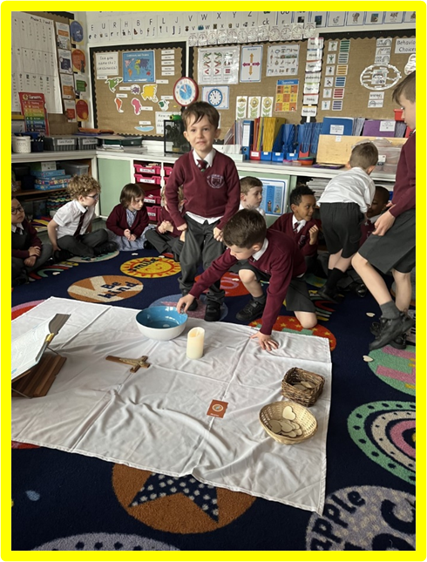
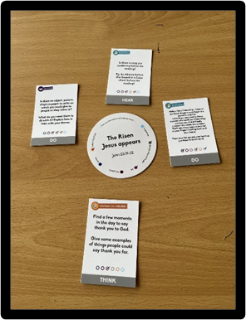
Prayerful Liturgy
Notes:
Every day, our children gather as a class or a school for Prayerful Liturgy. As well as whole school liturgies and our Celebration Assembly on a Friday, the children also take part Lectio Divina each week.
Our children are also supported to plan and lead their own class liturgy each week.
You will have opportunities during the year to gather with the Reception children in school for some liturgical celebrations. We have a Service for Mothers' Day in March and Liturgy for Mary in May. All are very welcome, and this is something the children and staff always look forward to.

Slide 22
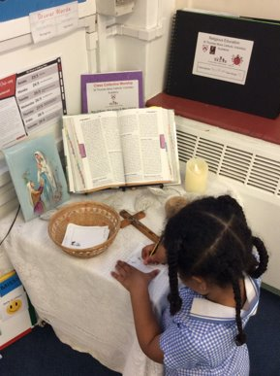
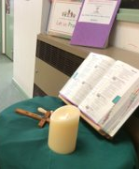
Prayer Tables
Notes:
Each Class has their own Prayer Table with a candle, crucifix and Bible. The prayer cloth is changed to fit the Liturgical season and children refer to our weekly Liturgical calendar to check the colour and to include any saints in our daily class prayers.

Slide 23
Inclusivity
Notes:
We are a Catholic School and have a duty to spend 10% of our curriculum time teaching Religious Education.
As well as regular prayer and liturgy we also seek to discover more about the other faiths and cultures which are shared by our children and their families.
Children who celebrate other special days in their own faith are supported and we encourage the sharing of knowledge and information at these times. Our Religious Education curriculum teaches respect for other world religions, and we learn about the practices and beliefs of other faiths including Judaism, Islam and the Dharmic religions.

Slide 24
The Early Years Foundation Stage Curriculum

Slide 25
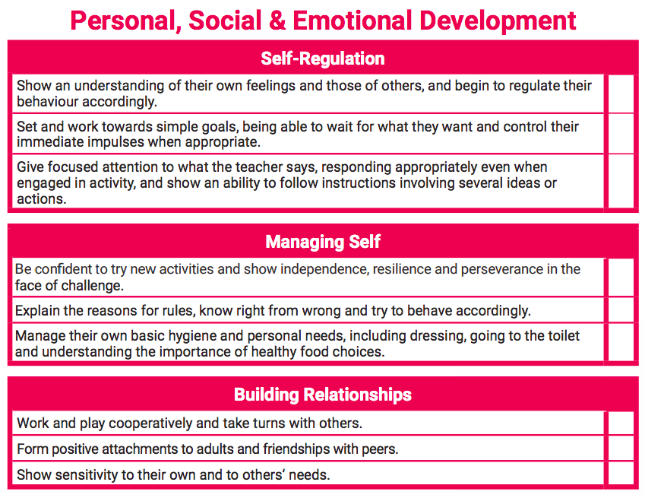
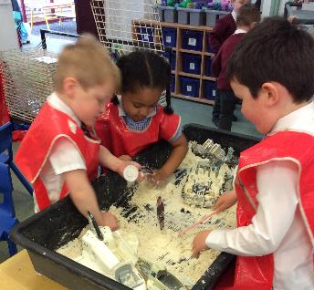
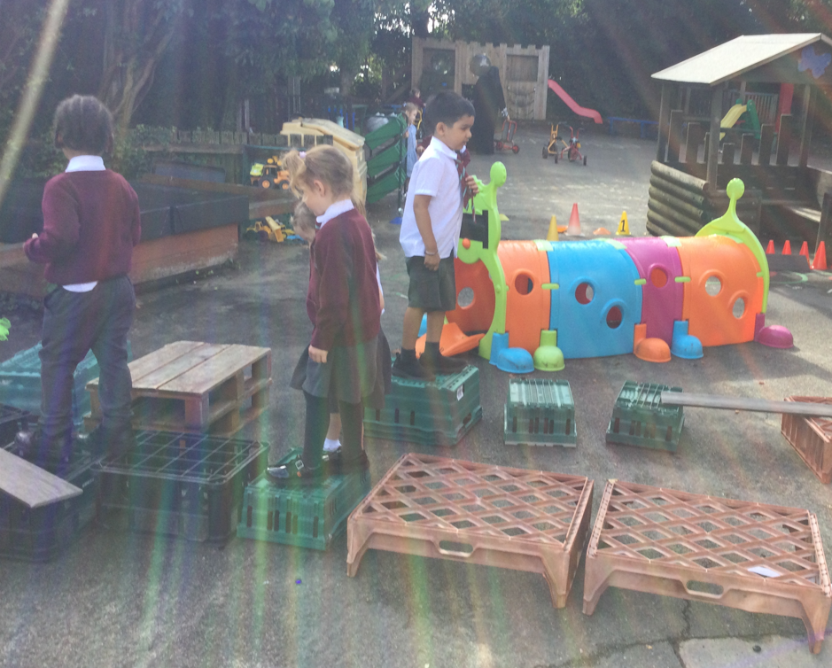

Slide 26
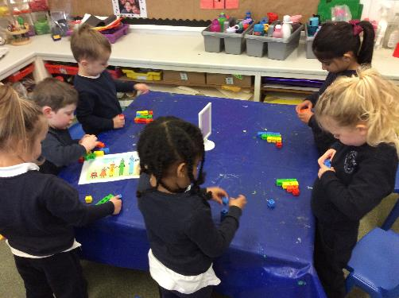
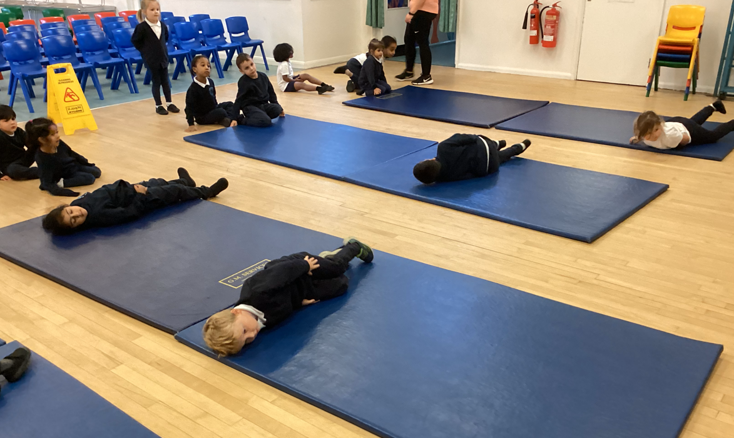
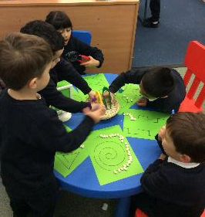
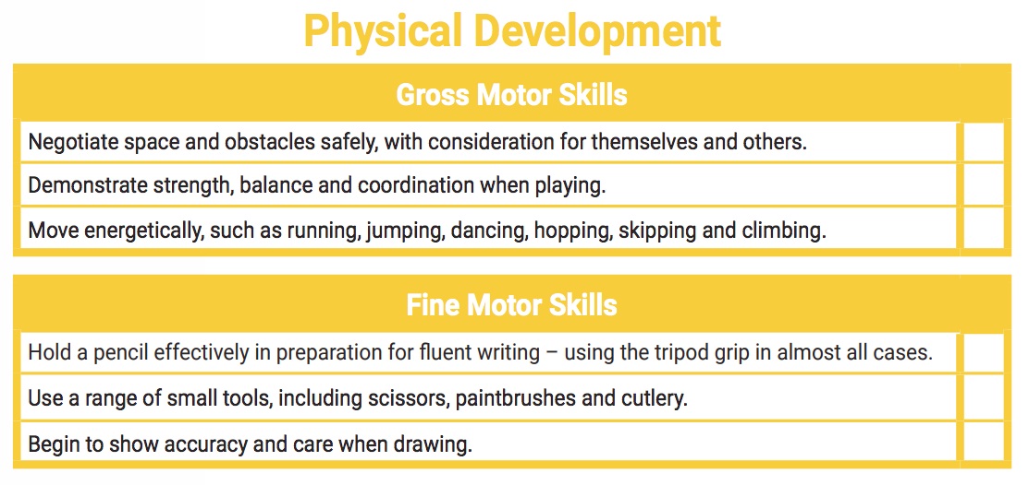

Slide 27
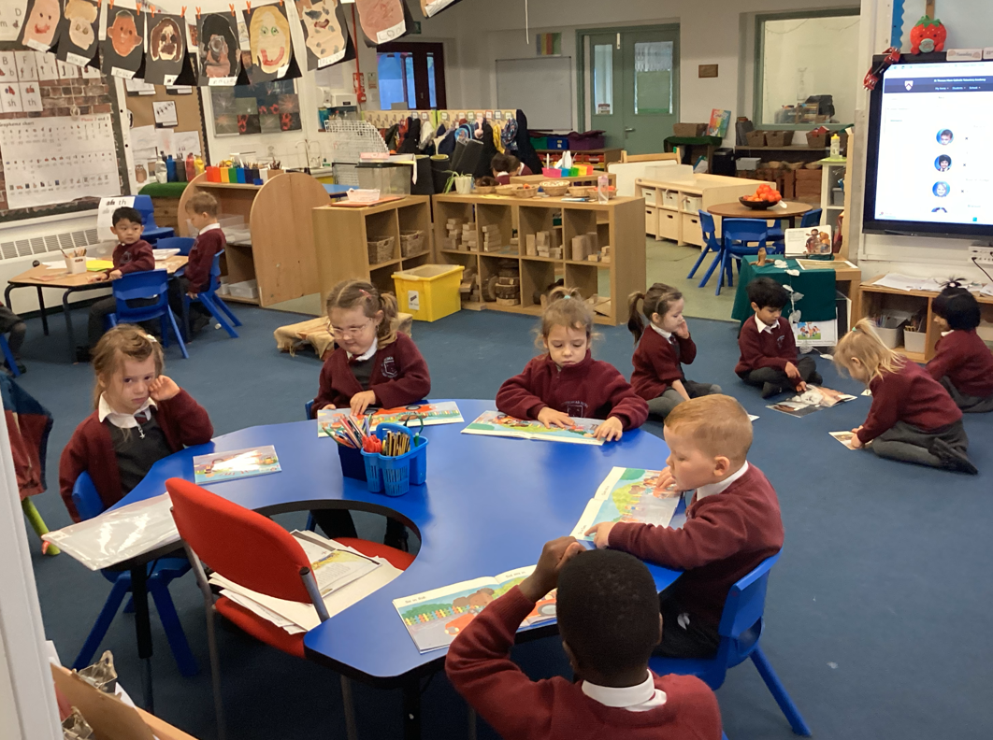
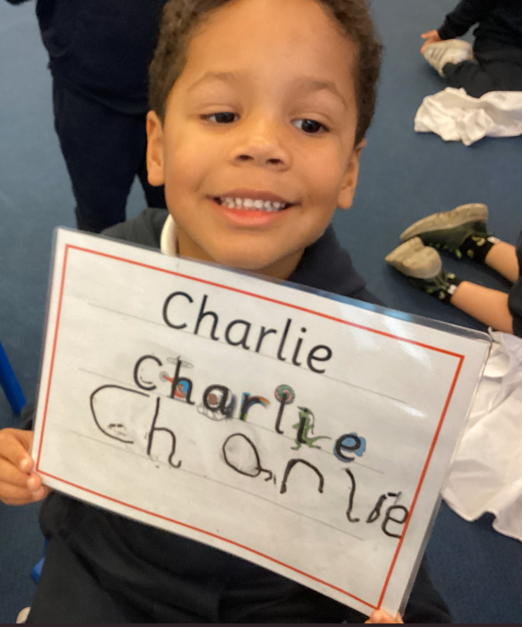
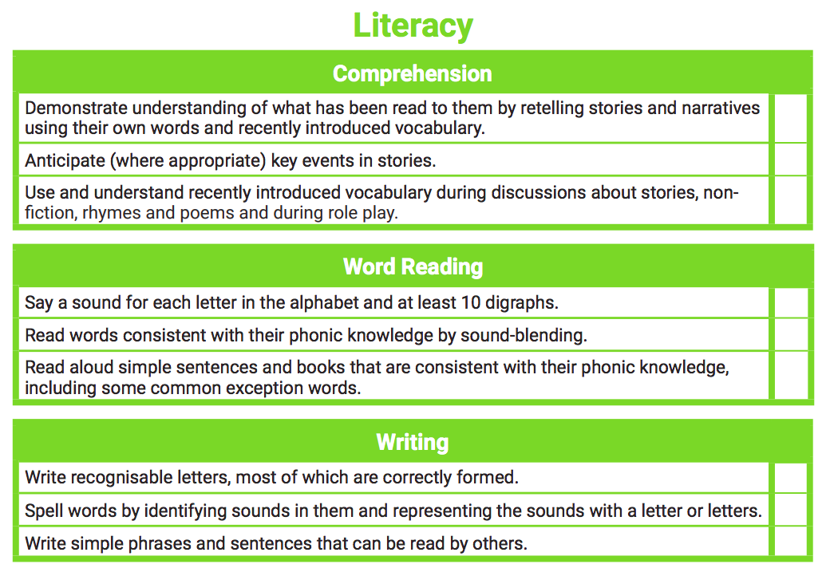
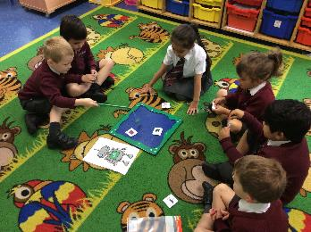

Slide 28
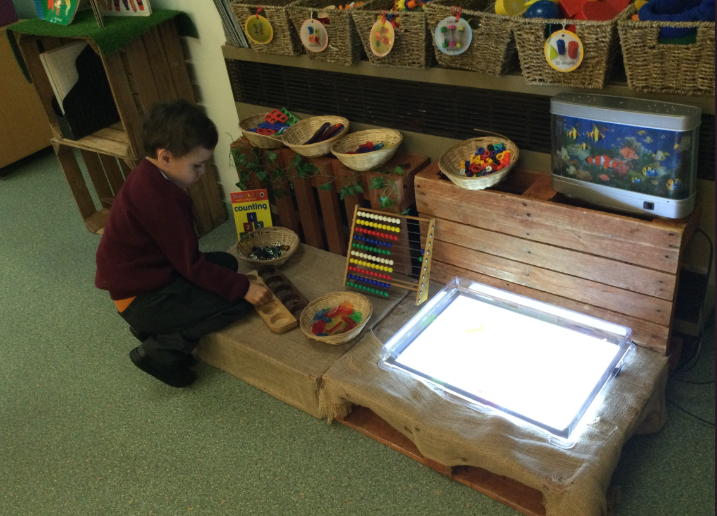
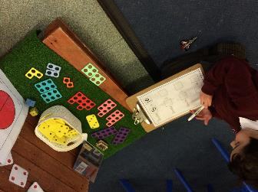
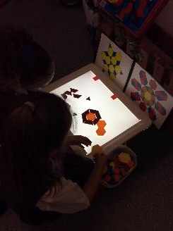
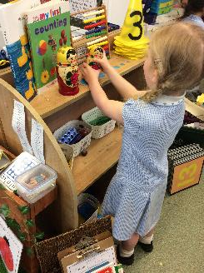

Slide 29
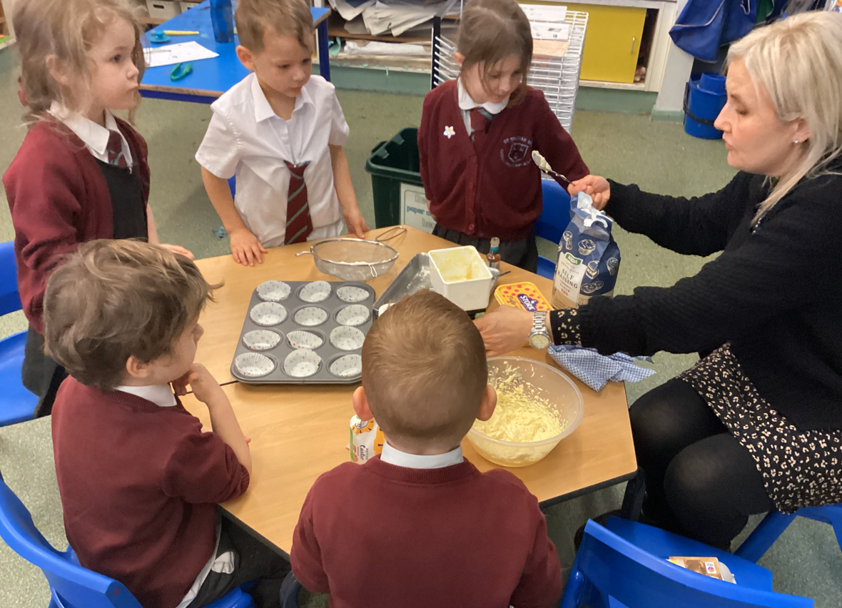
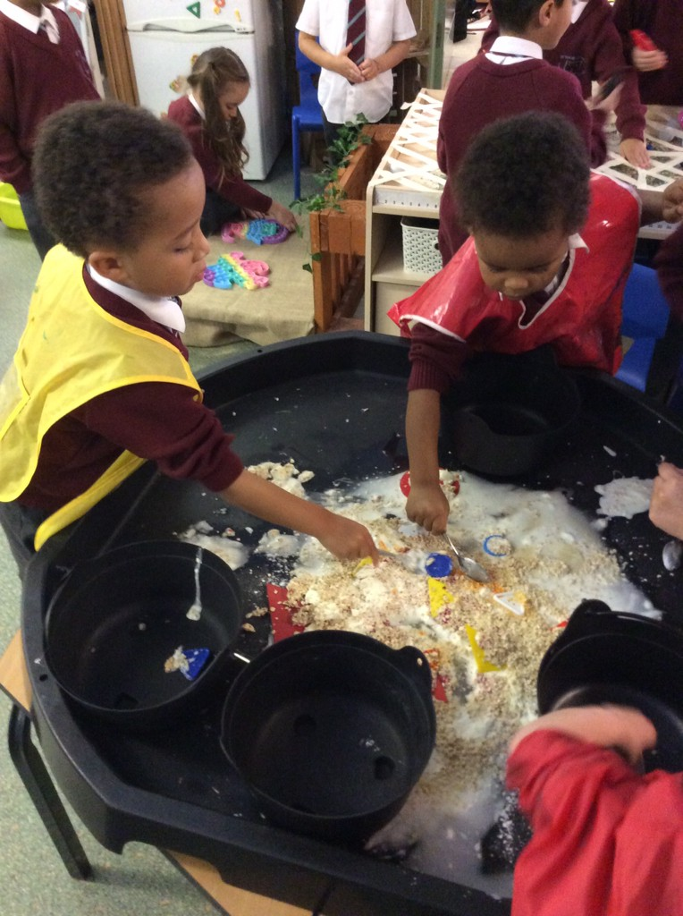
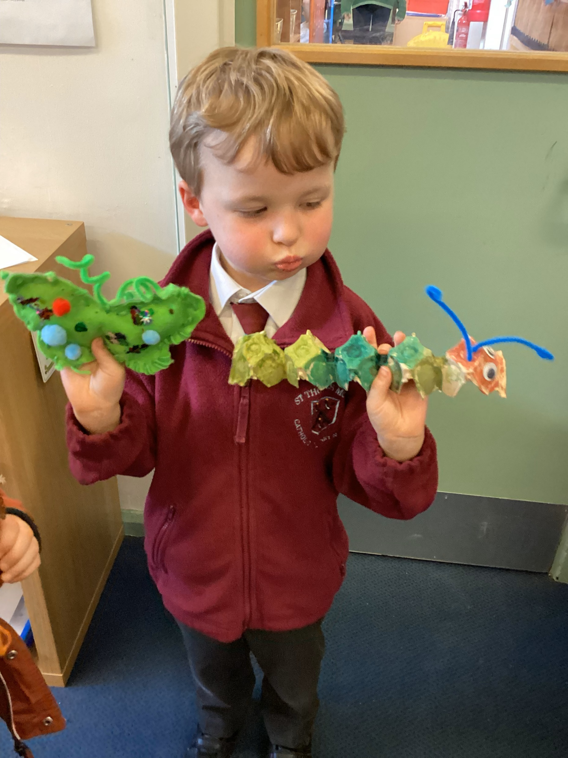
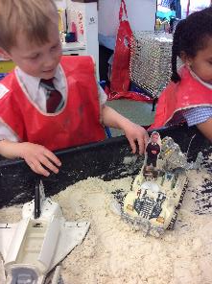

Slide 30
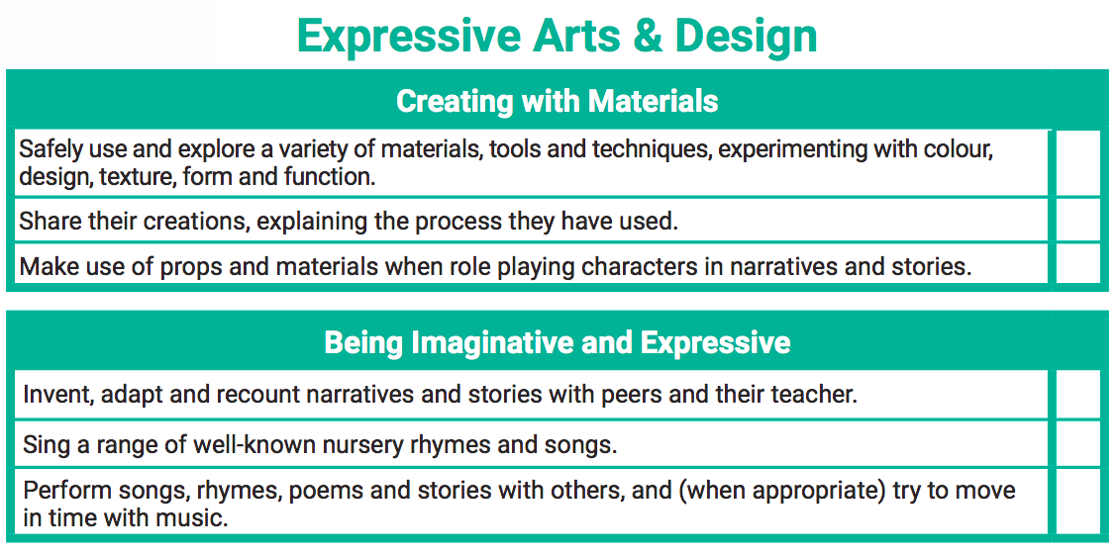
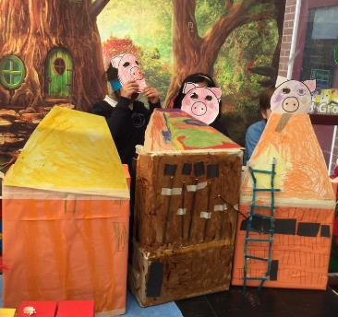
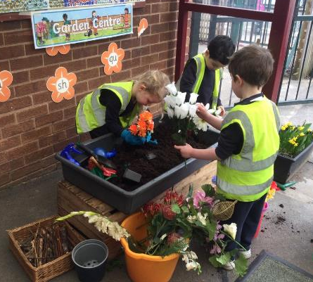
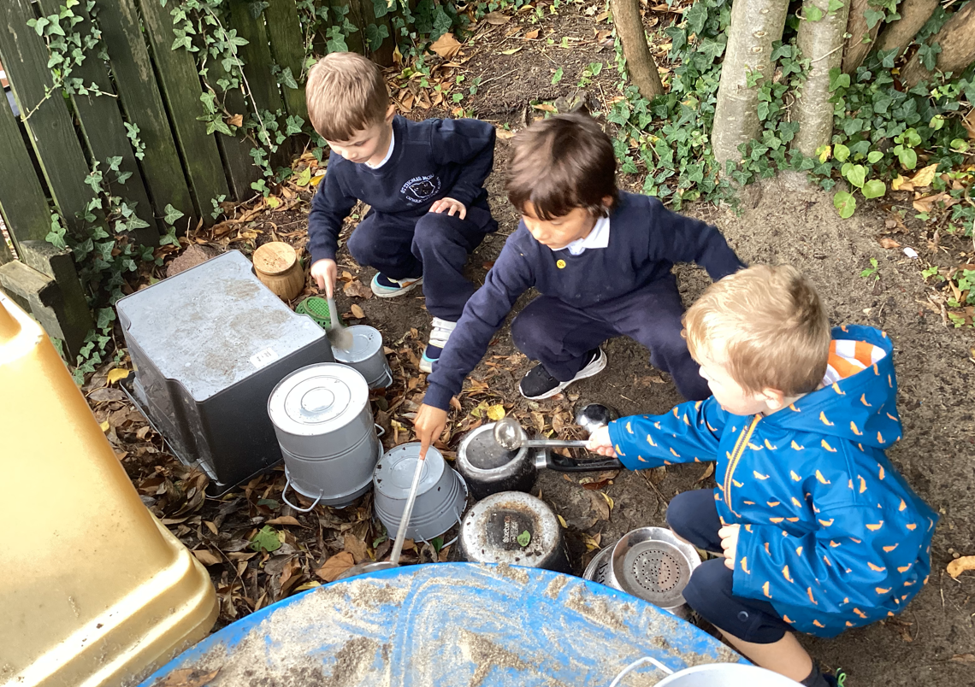

Slide 31
Characteristics of Effective Learning
Notes:
We also observe and note the ways in which the children engage with other people and their environment. These behaviours underpin learning and development across all areas and support the child to remain an effective and motivated learner.
Creating and Thinking Critically – this is having their own ideas, making links and choosing ways in which to do things.
Playing and Exploring – Engagement – this is finding out and exploring, playing with what they know, being willing to ‘have a go’.
Active Learning – Motivation – this is being involved and concentrating, keeping trying, enjoying achieving what they set out to do.

Slide 32
Baseline
Notes:
The RBA is a short, interactive and practical assessment of your child's early literacy, communication, language and mathematics skills when they begin school, using materials that most children of your child's age will be familiar with. It became statutory for all schools from September 2021. This will be completed in the first 6 weeks of your child starting school.

Slide 33
Any other questions?

