Slide 1
Long multiplication
Adapted from:

Slide 2
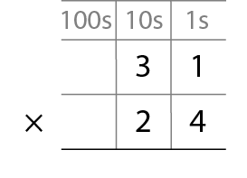
Example 1: multiply a 2-digit number by a 2-digit number
Step 1 – write the numbers being multiplied
Adapted from:

Slide 3
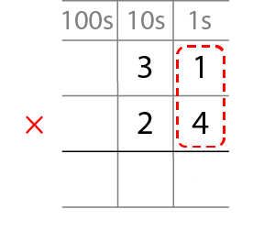
Example 1: multiply a 2-digit number by a 2-digit number
Step 2 – multiply the 1s digit by the 1s digit
Adapted from:

Slide 4
Example 1: multiply a 2-digit number by a 2-digit number
Step 3 – multiply the 10s digit by the 1s digit and carry/regroup
1
2
Adapted from:

Slide 5
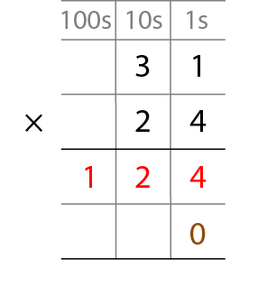
Example 1: multiply a 2-digit number by a 2-digit number
Step 4 – place a 0 to show that it’s 10 times the size
1
2
Adapted from:

Slide 6
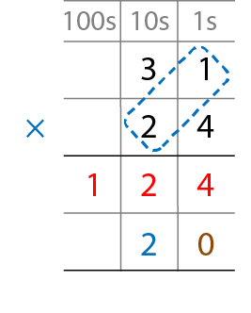
Example 1: multiply a 2-digit number by a 2-digit number
Step 5 – multiply the 1s digit by the 10s digit
Adapted from:

Slide 7
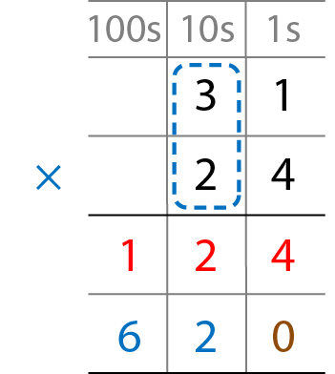
Example 1: multiply a 2-digit number by a 2-digit number
Step 6 – multiply the 10s digit by the 10s digit
Adapted from:

Slide 8
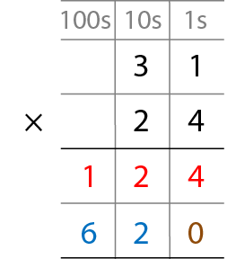
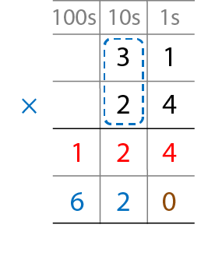
Example 1: multiply a 2-digit number by a 2-digit number
Step 7 – add the partial products
Adapted from:

Slide 9
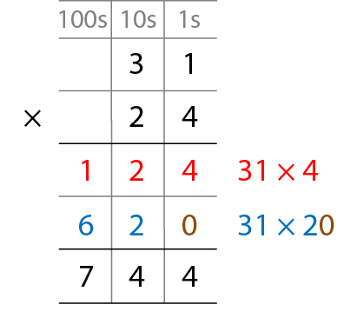
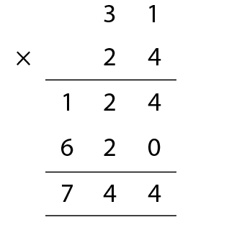
Example 1: multiply a 2-digit number by a 2-digit number
Adapted from:
Notes:
What’s the same? What’s different?

Slide 10
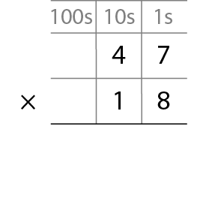
Example 2: multiply a 2-digit number by a 2-digit number
Step 1 – write the numbers to be multiplied (largest on top)
Adapted from:

Slide 11
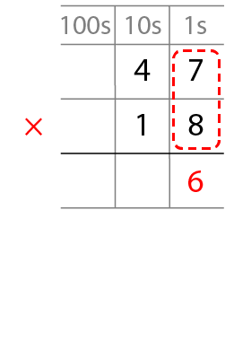
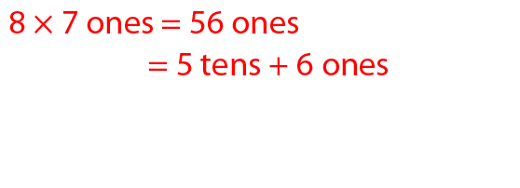
Example 2: multiply a 2-digit number by a 2-digit number
Step 2 – multiply the 1s digit by the 1s digit and carry/regroup
5
Adapted from:

Slide 12
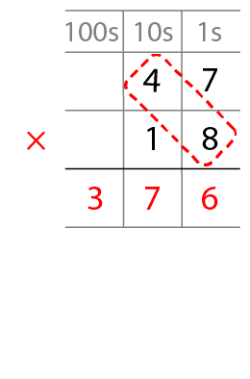
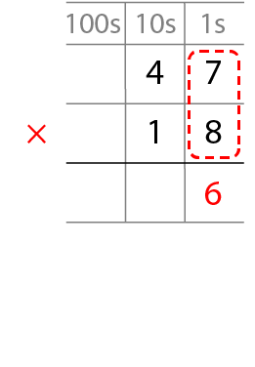
Example 2: multiply a 2-digit number by a 2-digit number
Step 3 – multiply the 10s digit by the 1s digit,
adding the carried/regrouped 10s and carry/regroup again
5
Adapted from:

Slide 13
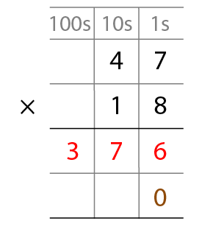
Example 2: multiply a 2-digit number by a 2-digit number
Step 4 – place a 0 to show that it’s 10 times the size
Adapted from:

Slide 14
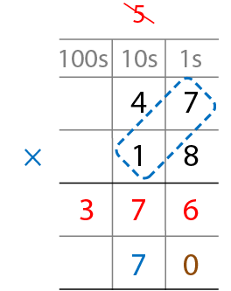
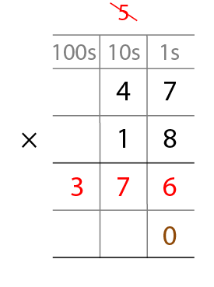
Example 2: multiply a 2-digit number by a 2-digit number
Step 5 – multiply the 1s digit by the 10s digit
Adapted from:

Slide 15
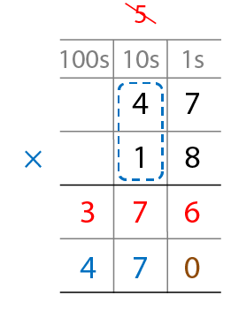
Example 2: multiply a 2-digit number by a 2-digit number
Step 6 – multiply the 10s digit by the 10s digit
Adapted from:

Slide 16
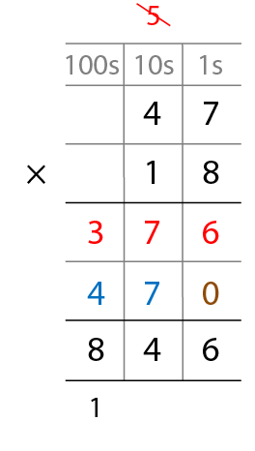
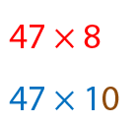
Example 2: multiply a 2-digit number by a 2-digit number
Step 7 – add the partial products
Adapted from:

Slide 17
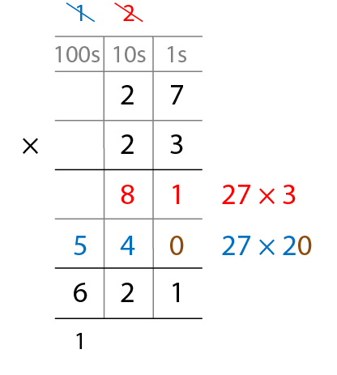
Example 3: multiply a 2-digit number by a 2-digit number
27 × 23
Adapted from:

Slide 18
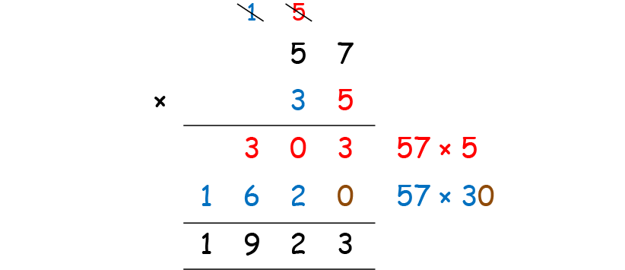
Example 4: multiply a 2-digit number by a 2-digit number
Spot the mistake!
Adapted from:
Notes:
Lesa has done this calculation but has the incorrect answer.
Explain her mistake.

Slide 19
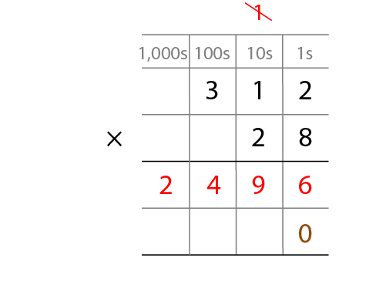
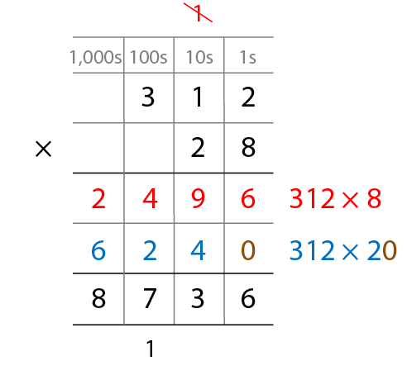
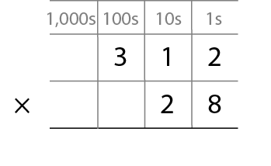
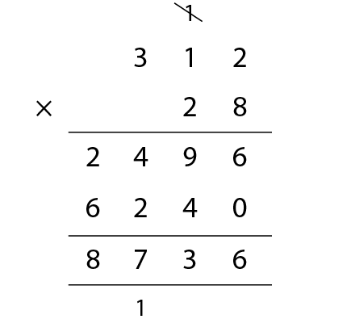
Example 5: multiply a 3-digit number by a 2-digit number
Adapted from:

Slide 20
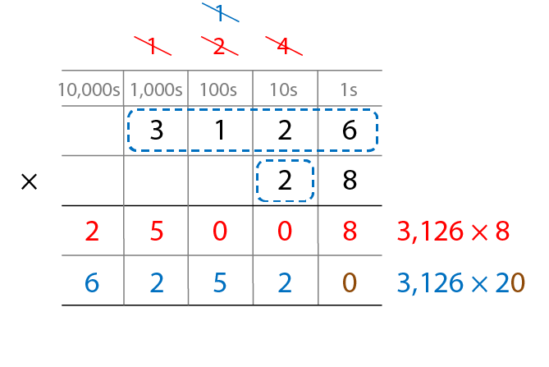
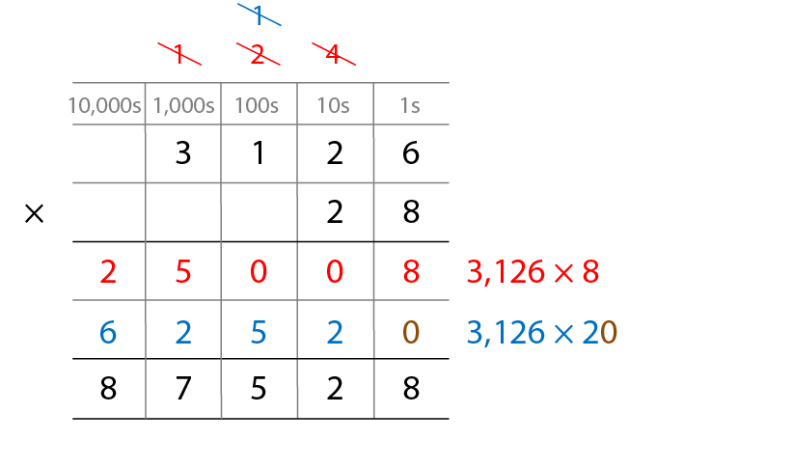
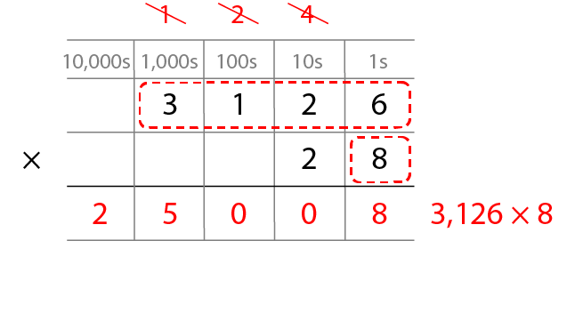
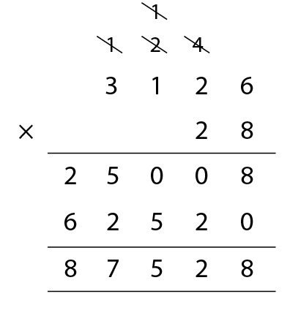
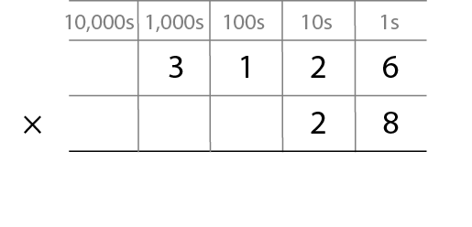
Example 6: multiply a 4-digit number by a 2-digit number
Adapted from:

